Slide 1
Container Gardening
Kale
Give it some space in a container with a minimum 12” diameter with a depth of at least 12”
Larger containers, space the plants 12 inches apart
Provide proper drainage add stones, walnut shells, broken pottery, etc.
Lettuce (harvest leaves)
Shallow roots don't need deep soil
Wide and shallow (6+ inches) container
Shallow container will need more watering
Adequate drainage holes in the bottom

Slide 2
Kale Cheat Sheet
Change planting location, no replanting for 2-4 years
Full sun spring/fall, shade in summer
Make sure seedling and planting location are moist before transplanting
Gently massage roots before planting
Do not compact soil surface but press in and around plug and loosely fill rest of the area
~12 inches apart in all directions
Bury to apex or axis point
Initial water regularly for 3-4 days straight
Subsequent watering is temperature dependent (3-4 days)
Harvest from bottom up, leave ½ vegetation
Remove all yellowed/damaged leaves
Notes:
Plants, like people, influence one another. Some get along better together than others. Black walnut and butternut have an antagonistic relationship with tomatoes, for example. The toxin juglans exuded from the trees’ roots is quite toxic to several plants, including those of the nightshade family such as tomato, pepper, and eggplant. Plant neighbor relationships might take several forms. First, they may improve the health or flavor of a companion. Second, they may interfere with the growth of a neighbor. Third, they may repel or trap an undesirable critter. Companion plant may also attract a beneficial insect.

Slide 3
Lettuce Cheat Sheet
Leaf harvest: plant 3”< apart
Head harvest: plant 10”-12” apart
Plant deep enough so seedling is upright
Make sure seedling and planting location are moist before transplanting
Light, slow watering every day for 3-4 days straight
Subsequent low pressure soaker hose for deep watering every (3-4 days)
Check soil moisture a few inches below surface
Harvest leaves in the AM leaving an inch
Harvest head in the AM leaving 2-4 inches

Slide 4
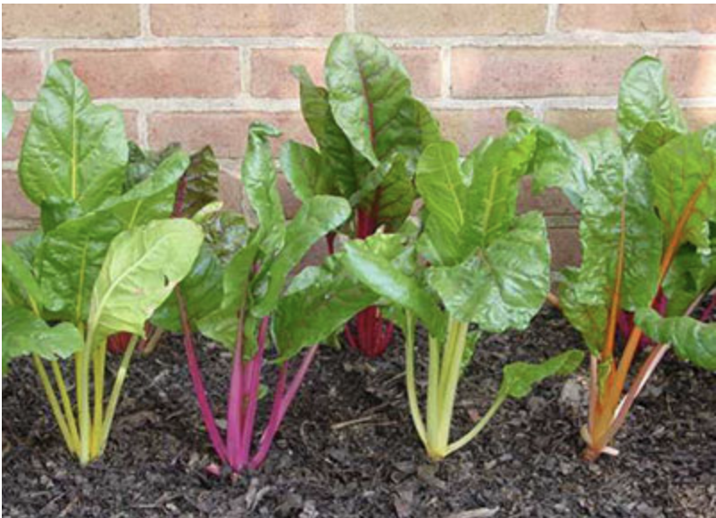
Planting, Fertilizing & Watering Chard
Soil: moist, well-drained, loose to 8 inches, and well amended with compost, ph 6 – 6.8, slightly acidic. Full sun/Light shade
Water starts before planting. Plant 4 – 8 inches apart in rows 12 inches apart.
Fertilizing: Add a source of organic nitrogen before planting, blood meal or alfalfa meal are good choices.
Foliar applications (3 x a season) of all-purpose organic or kelp spray will boost production
Water—leafy greens need water—about 1.5 inches per week, drip is better for leaf health and to keep pests away.

Slide 5
Chard Cheat Sheet
Change planting location, no replanting for 2-4 years
Full sun or mild shade
Make sure seedling and planting location are moist before transplanting
Gently massage roots before planting
Do not compact soil surface but press in and around plug and loosely fill rest of the area
4 – 8 inches apart in 12 inch rows (depending how big you are growing the leaves)
Bury to apex or axis point
Initial water regularly for 3-4 days straight
Subsequent watering is temperature dependent (1.5 inches per weel)
Harvest largest leaves, leaving three leaves to regrow more.
Remove all yellowed/damaged leaves

Slide 6
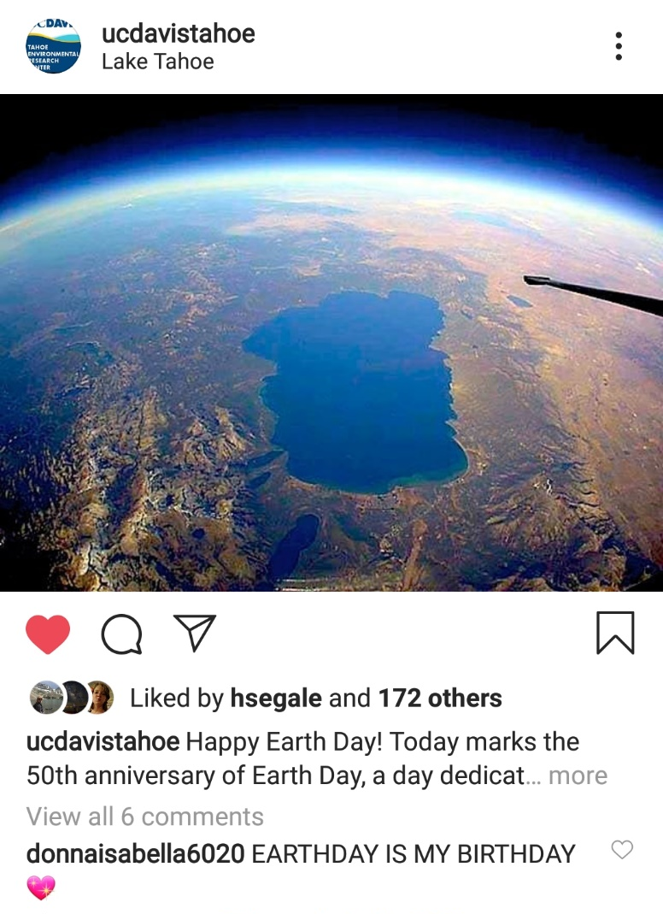
Social Media/Humble Brag
@pepperbutt
@ucdavistahoe
@slowfood_lt

