Slide 1
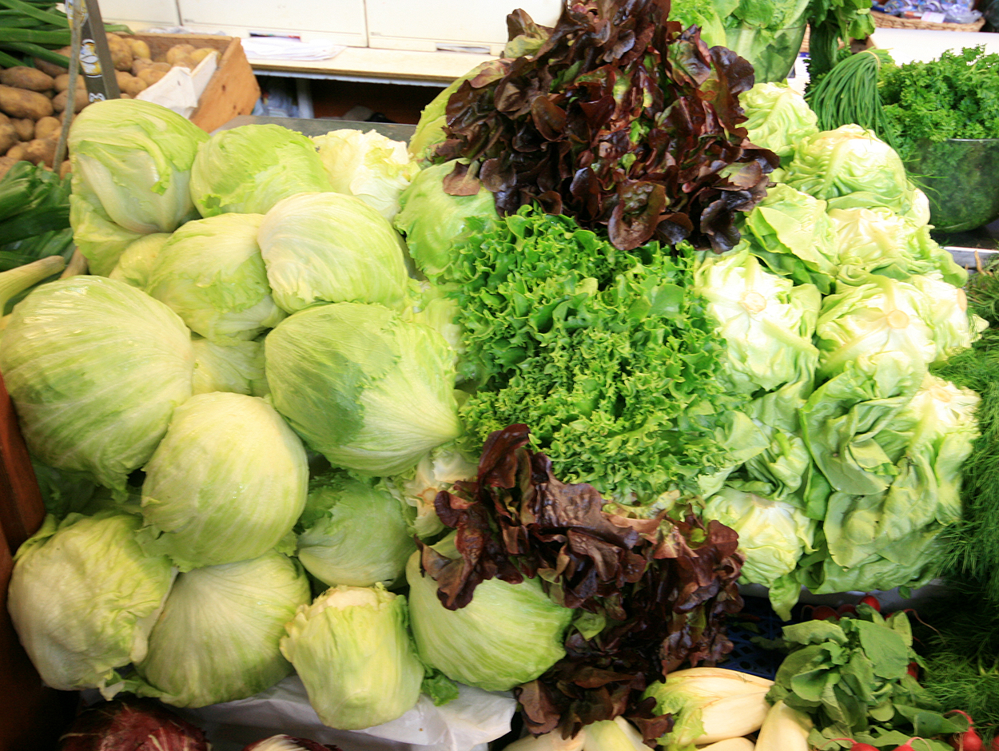
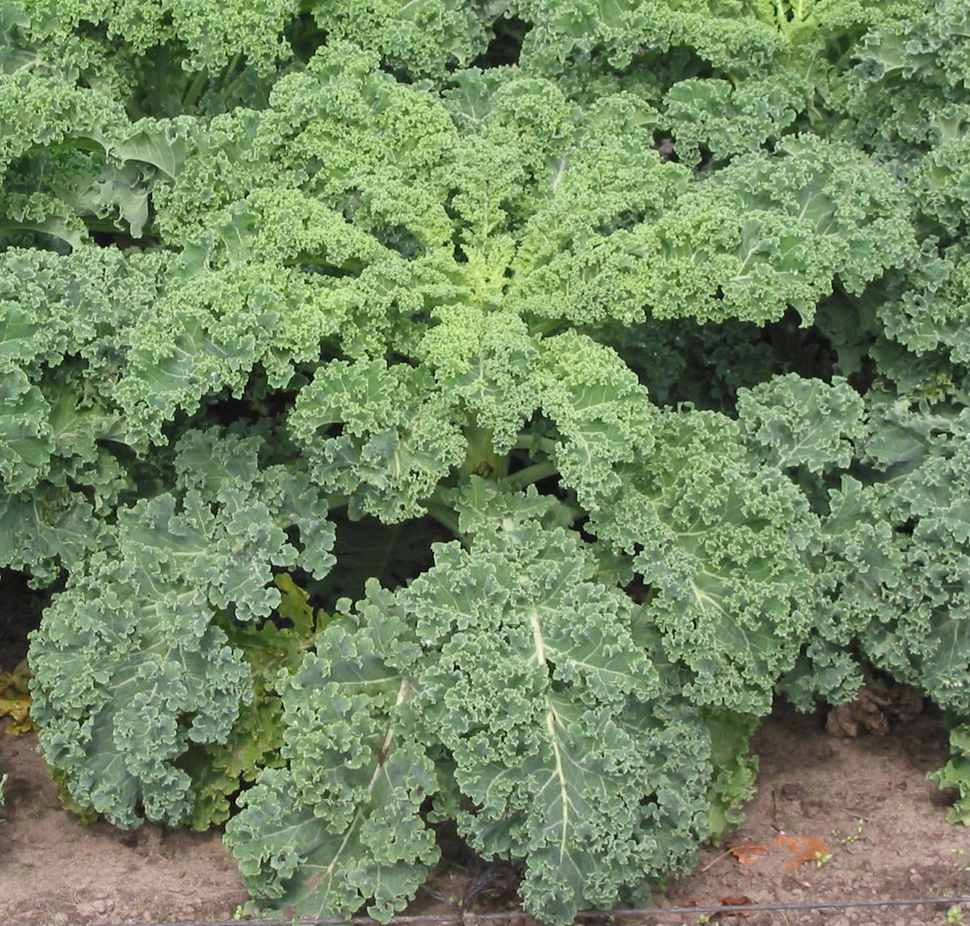
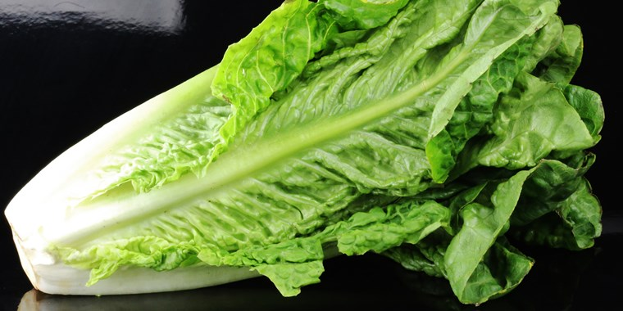
Tahoe Fruit & Vegetable Workshop Series Lettuce & Kale
Wikipedia image
passingthru.com image
Wikipedia image

Slide 2
Tahoe Fruit & Vegetable Workshop Series Lettuce & Kale
Project overview
Phenology
Scientific Classification & Plant Lifecycle
Varieties
Nutrition
History and Culinary Aspects
Planting and care
Workshop Pants & Supplier information
Distribution of Plant Paterials
Wikipedia image

Slide 3
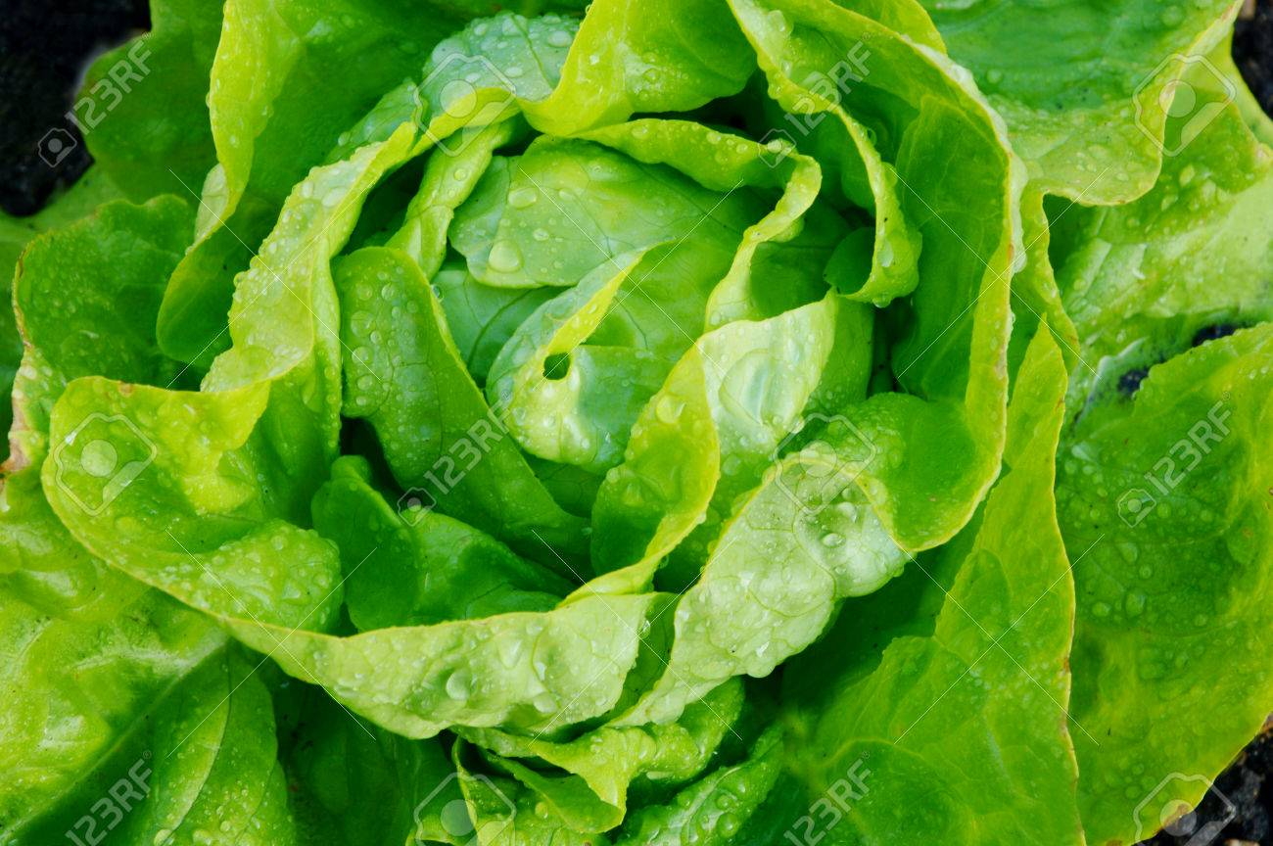
Tahoe Fruit & Vegetable Workshop Series Lettuce & Kale
Master Gardeners are community members who have been trained under the direction of the University of California (Davis) Cooperative Extension. 50 hours of formal classroom training
We assist the UC Cooperative Extension by providing practical, scientific gardening information to the home gardeners in the Lake Tahoe Basin.
The Lake Tahoe Master Gardeners offer research-based information by:
Answering questions via email hotlines, farmers markets and at community events.
Offering workshops and classes
123RF Image

Slide 4
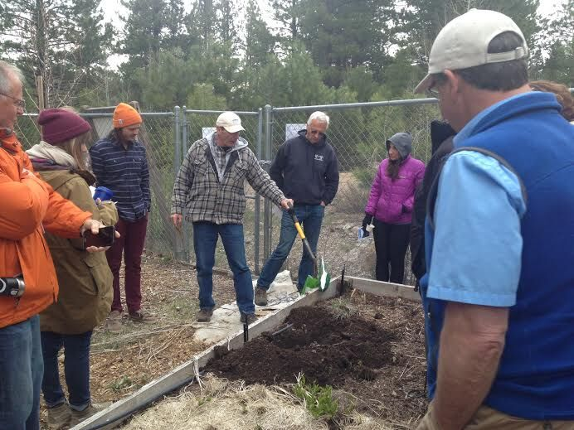
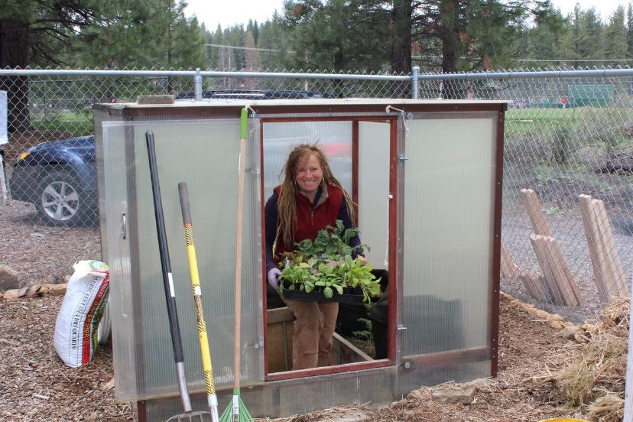
Tahoe Fruit & Vegetable Workshop Series Lettuce & Kale
Master Gardeners engage in the Community
School Gardens
Workshops
Community Gardens

Slide 5
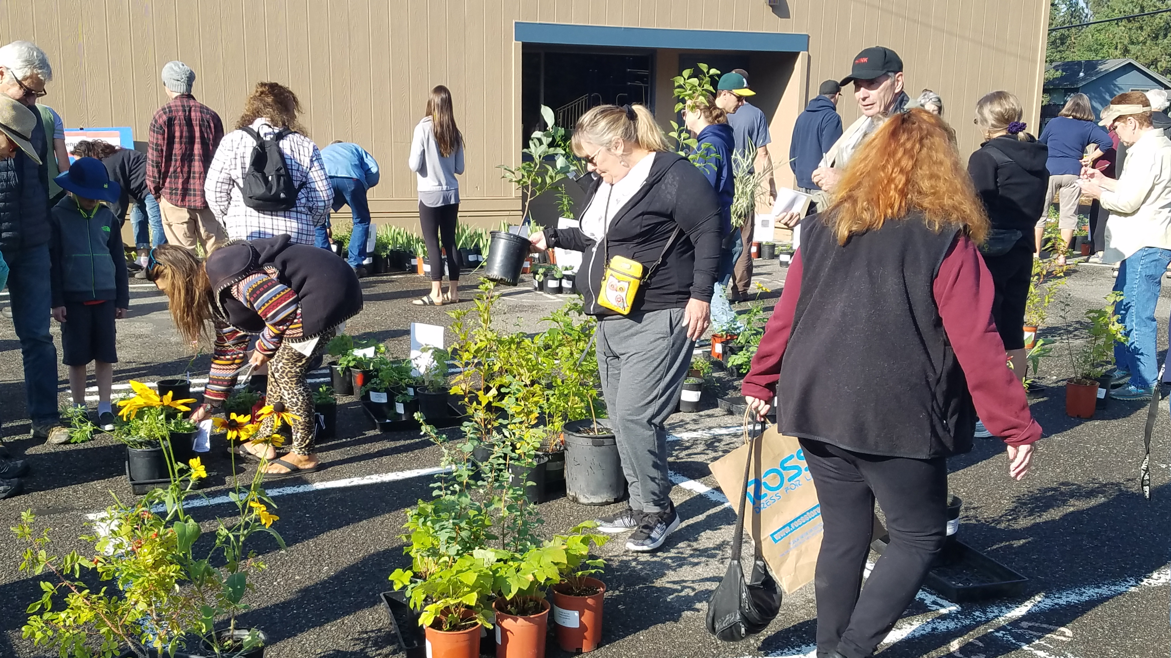
Tahoe Fruit & Vegetable Workshop Series Lettuce & Kale
Master Gardeners
engage in the Community
Plant Sales
Farmers Markets

Slide 6
Tahoe Fruit & Vegetable Workshop Series Lettuce & Kale
Phenology
General Phenology looks at growth and development of plant that are due to weather and climate
Varietal Comparative Phenology (VCP) compares growth and development among several plant varieties that are due to weather and climate
Tahoe phenology
Merriam-Webster on-line Dictionary

Slide 7
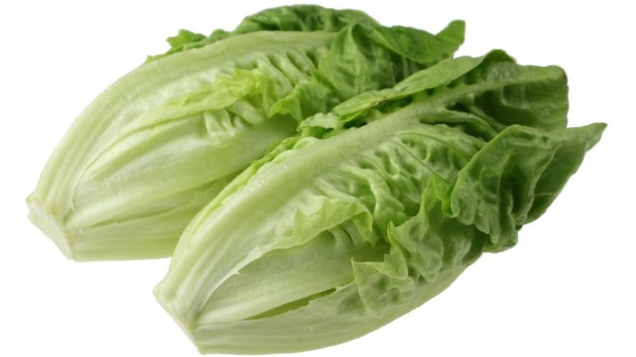
Tahoe Fruit & Vegetable Workshop Series Lettuce & Kale
Why grown lettuce and kale in the Tahoe Basin?
Popular food: lettuce ranks second only to potatoes in number of servings per person
Kale has grown in popularity
Both are very Nutritious
Fairly easy to grow in summer at high altitudes

Slide 8
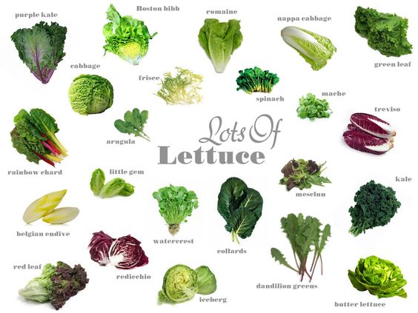
Tahoe Fruit & Vegetable Workshop Series
Lettuce & Kale
SALAD
Fixings
BrownBoxSoil image
Notes:
Research of lettuce, many species seem to be considered a lettuce. I am focusing todays presentation on what I call true lettuce and kale

Slide 9
Tahoe Fruit & Vegetable Workshop Series
Lettuce & Kale
Lettuce & Kale
BrownBoxSoil image

Slide 10
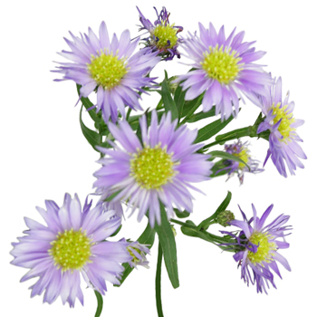
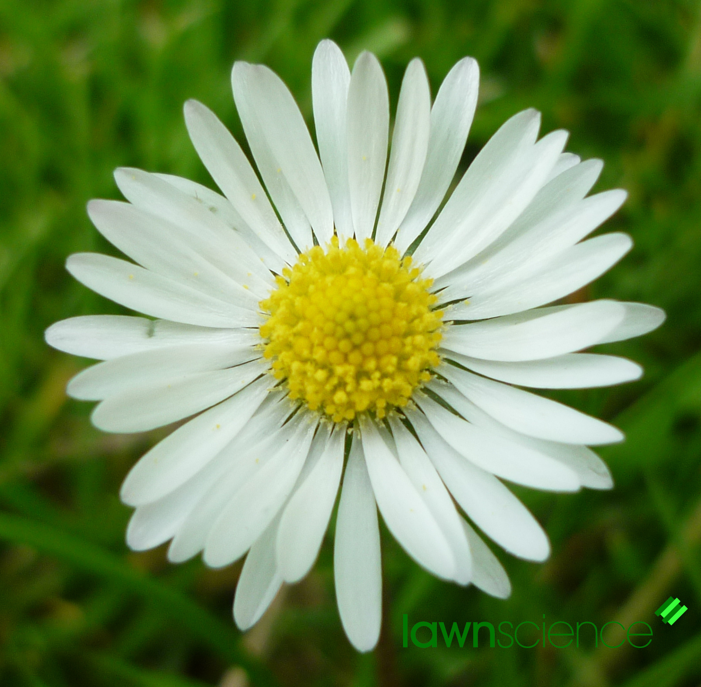
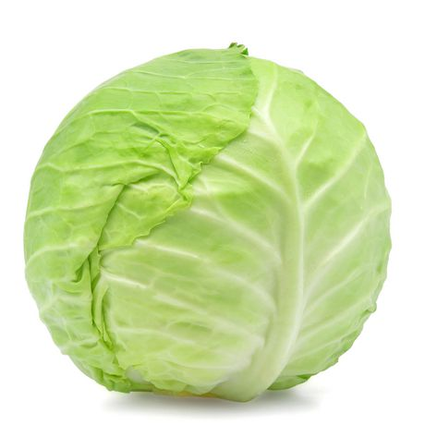
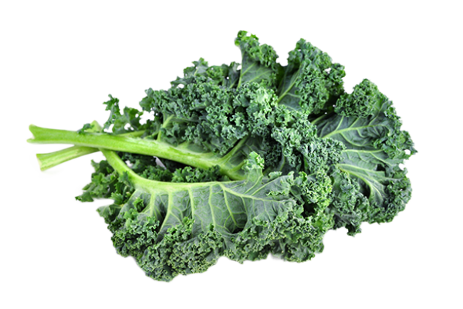
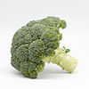
Tahoe Fruit & Vegetable Workshop Series Lettuce & Kale
Scientific Classification
Lettuce: Lactuca sativa
Is in the daisy family which
includes asters and sunflowers
Kale: Brassica oleracea var. viridis
Same species as cabbage, broccoli and
cauliflower only variety differs
Notes:
The white sap is a milky fluid made of latex that's naturally found in the lettuce and is completely harmless. The botanical name for the substance is lactucarium, which comes from lactus, the Latin word for milk (the botanical name for lettuce is lactuca sativa, which also stems from this word).Aug 2, 2016

Slide 11
Tahoe Fruit & Vegetable Workshop Series Lettuce & Kale
Life Cycle of Lettuce
Seed Stage
Dormant
Germinating (5 days)
Vegetative
Seedling (7 – 14 days)
Head formation (45- 90 days)
Bolting (30 days)
Reproductive
Flowering (14 days)
Ripening (11-13 days)

Slide 12
Tahoe Fruit & Vegetable Workshop Series Lettuce & Kale
Life Cycle of Kale
Seed Stage
Dormant
Germinating (4-7 days)
Vegetative
Seedling (7 – 14 days)
Head formation (none)
Bolting (2nd year)
Reproductive
Flowering (2nd year
Ripening (?)

Slide 13
Tahoe Fruit & Vegetable Workshop Series Lettuce & Kale
Lettuce Varieties
Romaine
Aka Cos Lettuce
Outer leaves removed: Hearts of Romaine
Thick center rib gives it a real crunch
Rib also gives this lettuce a slight bitter taste
Caesar salad

Slide 14
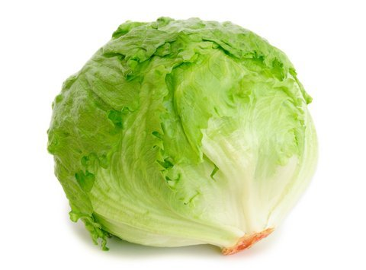
Tahoe Fruit & Vegetable Workshop Series Lettuce & Kale
Lettuce Varieties
Iceberg
The most popular type in the US
Very heat-sensitive and was originally adapted for growth in the northern US
Ships well
Low in flavor and nutritional content
Amazon.com image
Notes:
The most popular type in the US, it is very heat-sensitive and was originally adapted for growth in the northern US. It ships well, but is low in flavor and nutritional content, being composed of even more water than other lettuce types

Slide 15
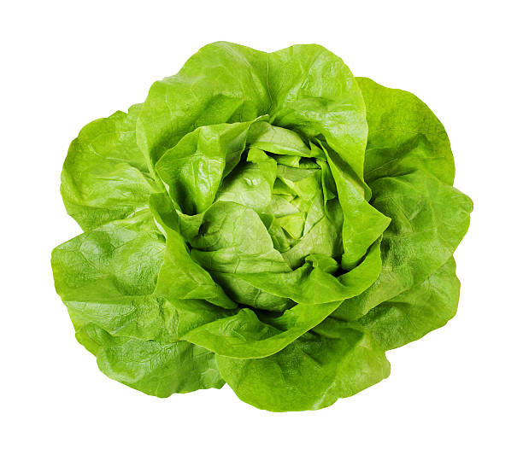
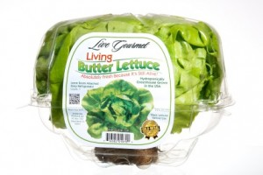
Tahoe Fruit & Vegetable Workshop Series Lettuce & Kale
Lettuce Varieties
Butterhead
Aka Butter lettuce, Bib lettuce, Boston lettuce
Leaves are soft and delicate
Texture smooth like butter
Sometimes sold “living”
iStock image
Live Gourmet image

Slide 16
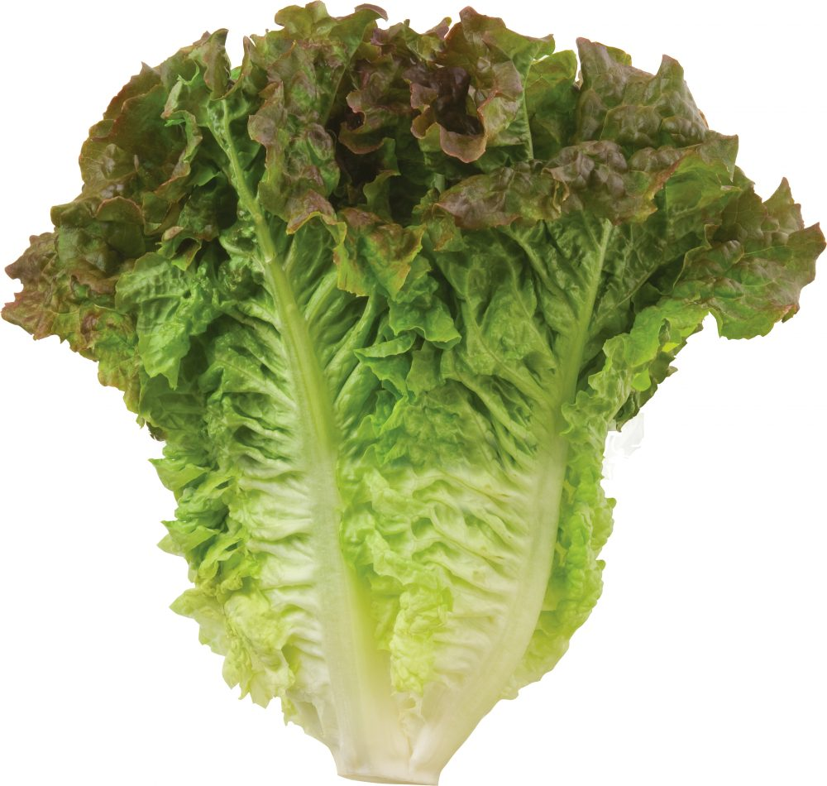
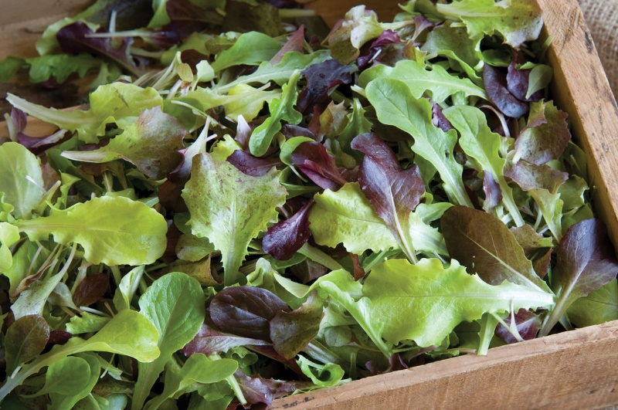
Tahoe Fruit & Vegetable Workshop Series Lettuce & Kale
Lettuce Varieties
Green Leaf
Aka Loose Leaf lettuce
Ruffled edges
Mild flavor
Hardy
Continual harvest
Eaten raw or sautéed or grilled
Tanimura & Antle image
Johnny’s Selected Seeds image

Slide 17
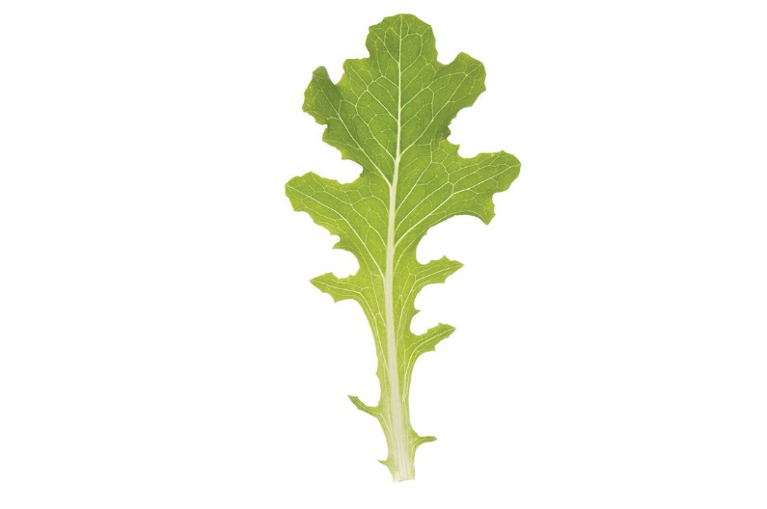
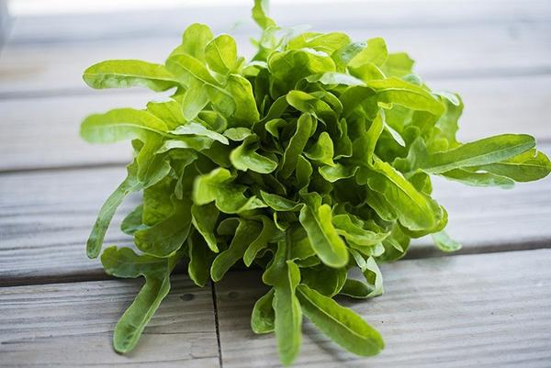
Tahoe Fruit & Vegetable Workshop Series Lettuce & Kale
Lettuce Varieties
Oakleaf
Aka Red Oakleaf, Green Oakleaf
Shape similar to oak tree leaf
Mistake it for leaf lettuce
- Differences in shape and texture
- Oakleaves are a little shorter and more squat
- Tops of their leaves have a softer texture

Slide 18
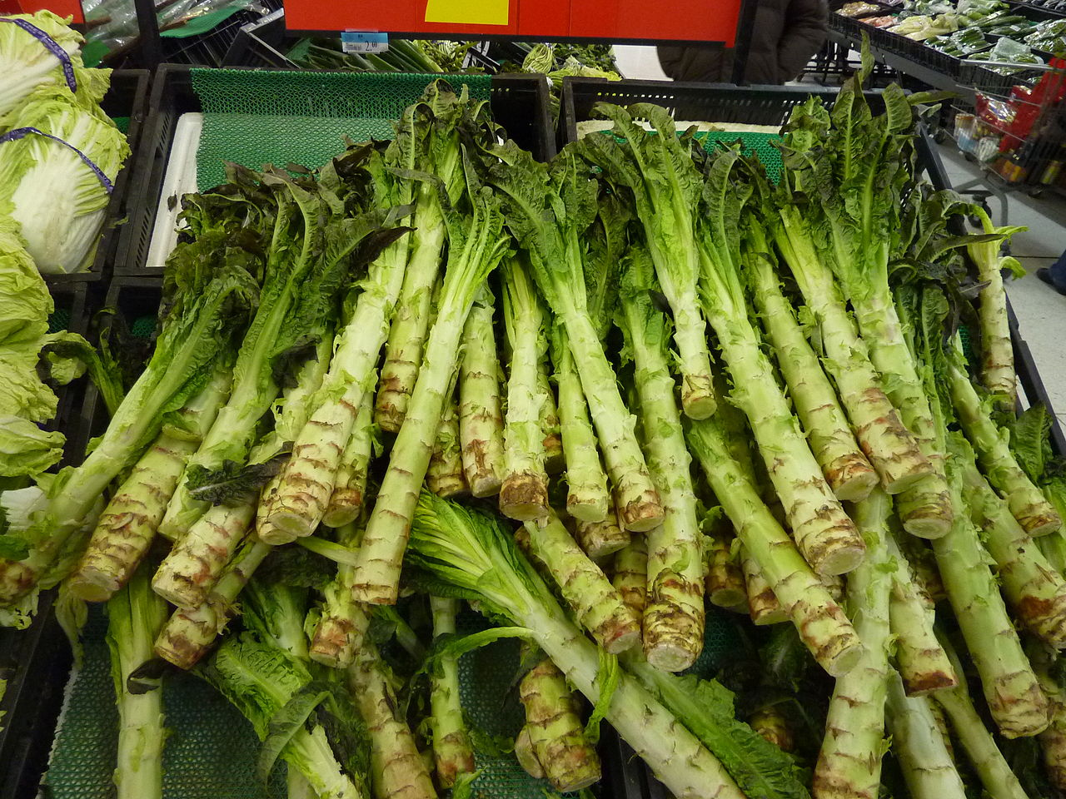
Tahoe Fruit & Vegetable Workshop Series Lettuce & Kale
Lettuce Varieties
Stem lettuce
Aka celtuce, “celery” and “lettuce.”
Grown for its stem
Used in Chinese cooking
Taste similar to hearts of palm, celery
Wikipedia image

Slide 19
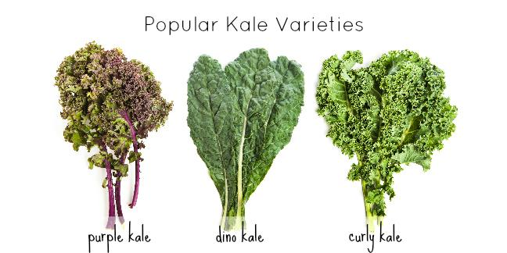
Tahoe Fruit & Vegetable Workshop Series Lettuce & Kale
Kale Varieties
Dino Kale
Purple Kale
Curly
Ornamental Kale

Slide 20
Tahoe Fruit & Vegetable Workshop Series Lettuce & Kale
Nutrition
Serving Size: 100 grams RAW
Average Daily Requirements
 | Iceberg | Romaine | Kale
Water | 96 g | 94 g | 90 g
Calories | 14 Cal | 17 Cal | 35 Cal
Carbs | 2% | 3% | 3%
Fiber | 5% | 8% | 16%
Calcium | 2% | 3% | 25%
Magnesium | 2% | 4% | 10%
Potassium | 3% | 5% | 7%
Vitamin C | 4% | 5% | 112%
Vitamin A | 63% | 55% | 55%
Calculated from
USDA Food Database
NIH, Dietary Reference Tables
Notes:
Leafy green vegetables like kale and lettuce are both rich in fiber and low in calories.
Kale is slightly higher in fiber content than lettuce. The high fiber content helps stabilize the leafy veggie during cooking.
Dark-colored leafy vegetables, such as kale, have a high calcium content.
Even though both kale and lettuce provide calcium, oxalic acid in these vegetables inhibits absorption. Oxalic acid binds with calcium so that your body cannot absorb it. Since absorption is limited, you need to consume nearly 2 cups of cooked kale, or 4 cups of raw kale, to get the same amount of bioavailable calcium found in 8 ounces of milk, says the Linus Pauling Institute.
Kale has more vitamin C than oranges in a 100 gram serving kale has 93 mg to the orange’s 59.
Kale is overflowing with essential nutrients such as calcium, lutein, iron, and Vitamins A, C, and K. Kale has seven times the beta-carotene of broccoli and ten times more lutein.

Slide 21
Tahoe Fruit & Vegetable Workshop Series Lettuce & Kale
History & Fun Facts
Lettuce
Native to Eastern Mediterranean region & Western Asia
Egypt 4500 BC Cultivation, Min god of Fertility
Ancient Greeks and Romans
China
Americas Columbus 1493
California 17th century
Refrigeration and railway transportation
Harmless white sap in homegrown lettuce gives scientific name
Notes:
Native to the eastern Mediterranean region and western Asia, lettuce has a long and distinguished history.
With depictions appearing in ancient Egyptian tombs, the cultivation of lettuce is thought to date back to at least 4500 BC. Egyptians believed lettuce to be an aphrodisiac. Egyptian lettuce was tall, straight. Lettuce was sacrificially offered to the god Min, then eaten by men in an effort to achieve potency. Lettuce was first cultivated in ancient Egypt for the production of oil from its seeds. This plant was probably selectively bred by the Egyptians into a plant grown for its edible leaves with evidence of its cultivation appearing as early as 2680 BC. Lettuce was considered a sacred plant of the reproduction god Min, and it was carried during his festivals and placed near his images. Its use in religious ceremonies resulted in the creation of many images in tombs and wall paintings.
The ancient Greeks and Romans held lettuce in high regard both as a food and for its therapeutic medicinal properties.
In China, where lettuce has been growing since the 5th century, lettuce represents good luck. It is served on birthdays, New Year's Day and other special occasions. NEXT PAGE
Christopher Columbus introduced varieties of lettuce to North America during his second voyage in 1493. Lettuce was first planted in California, the lettuce capital of the United States, by the Spanish missionaries in the 17th century. Its popularity across the US did not become widespread until centuries later with the development of refrigeration and railway transportation.
The white sap is a milky fluid made of latex that's naturally found in the lettuce and is completely harmless. The botanical name for the substance is lactucarium, which comes from lactus, the Latin word for milk (the botanical name for lettuce is lactuca sativa, which also stems from this word).Aug 2, 2016

Slide 22
Tahoe Fruit & Vegetable Workshop Series Lettuce & Kale
History & Fun Facts
Kale
Celts to Europe in 600 BC
Greece 400 BC
North America in 1500s by colonists
Canada in 1600 by Russians
Farmer’s markets, smoothies, foodies & chefs
Image by Jen Delyth
Notes:
Kale descends from the wild cabbage which originated in Asia. Kale is thought to have been introduced to Europe by the Celtics where it remained a staple.
But it is known that the ancient Greeks cultivated leafy greens, which they boiled and ate as a cure for drunkenness. And early Roman manuscripts include references to “brassica,” a word that encompassed wild turnips, cabbages and kalelike plants. By the Middle Ages, kale had spread through Europe and Asia . By the Middle Ages, kale had spread through Europe and Asia. The Italians developed plants with “dinosaur” scales, while the Scots created varietals with leaves like frilly petticoats. The Russians produced kale that could survive in the snow.
Kale was brought to North America by the colonists in the 16th century.^{[4]} Later, Russian kale was introduced into Canada, and then into the United States, by Russian traders in the 19th century.
The farmers’ markets that proliferated in the last decade, also helped to make kale the darling of foodies and chefs.

Slide 23
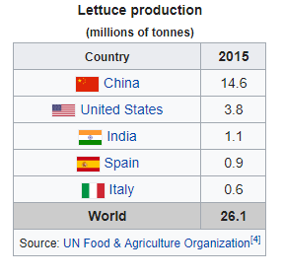
Tahoe Fruit & Vegetable Workshop Series Lettuce & Kale
History & Fun Facts
Lettuce
Notes:
Although China is the top world producer of lettuce, the majority of the crop is consumed domestically.
Spain is the world's largest exporter of lettuce, with the US ranking second.^{[27]}
Different locations tended to prefer different types of lettuce, with crisphead prevailing in northern Europe and US, romaine in the Mediterranean and stem lettuce in China and Egypt.

Slide 24
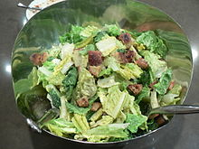
Tahoe Fruit & Vegetable Workshop Series Lettuce & Kale
Caesar Salad
Make the croutons
Make the dressing
Tear or cut Romaine
Mix together
Prepare the salad at the table for added drama.
Olive oil
Garlic
Croutons
Lemon juice
Parmesan cheese
anchovy paste or 1-2 anchovies
Raw or coddled eggs
Black pepper
Salt
ROMAINE Lettuce
Notes:
The salad's creation is generally attributed to restaurateur Caesar Cardini, an Italian immigrant who operated restaurants in Mexico and the United States.^{[2]} Cardini was living in San Diego but he was also working in Tijuana where he avoided the restrictions of Prohibition.^{[3]} His daughter Rosa (1928–2003) recounted that her father invented the salad when a Fourth of July 1924 rush A number of Cardini's staff have said that they invented the dish.^{[5][6]}
The Hotel Caesar's and Caesar's restaurant are still operating on Avenida Revolución in Tijuana today.
Julia Child said that she had eaten a Caesar salad at Cardini's restaurant when she was a child in the 1920s.^{[7]} .
According to Rosa Cardini, the original Caesar salad (unlike his brother Alex's Aviator's salad)^{[5]} did not contain pieces of anchovy; the slight anchovy flavor comes from the Worcestershire sauce. Cardini was opposed to using anchovies in his salad.^{[9]}
Caesar Salad the most popular restaurant salad in the country, with plenty of variations around the theme of romaine lettuce, garlic, Parmesan, and croutons.

Slide 25
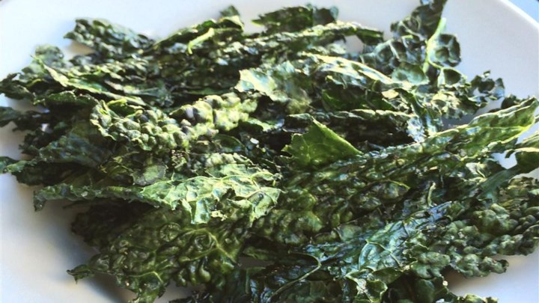
Tahoe Fruit & Vegetable Workshop Series Lettuce & Kale
Kale Chips
Olive oil
Seasoning of choice
Kale leaves
Trim away veins of kale
Mix seasoning with olive oil
Toss together
Arrange kale pieces on micro-wave safe plates, do not overlap
Cook each plateful of kale in microwave, until crispy (2-3 min), may need to turn once
Notes:
This is my receip adapted from one I found on Dr. Oz.

Slide 26
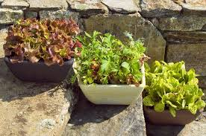
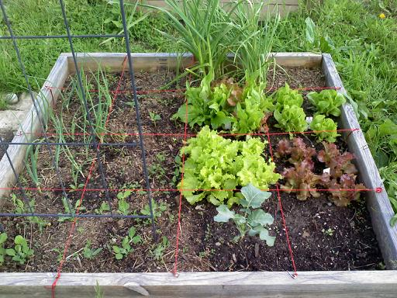
Tahoe Fruit & Vegetable Workshop Series Lettuce & Kale
Growing Lettuce
Prefers cool temperatures
Considered to be a spring crop
Requirements
Humus-rich, moisture-holding, but well-drained soil
Abundant in leaf-producing nitrogen
- manure & compost
Soil pH 6.5 to 7.0
Sunlight 3-8 (partial & full sun)
Water 3-5 days
Notes:
lettuce prefers cool temperatures and is considered to be a spring crop. However, unless your summers are extremely hot or your winters incredibly cold, there are fairly simple ways to extend the lettuce season. Fall, pound of fresh manure per square foot, letting it age over winter for spring planting. Some merely mix in aged manure and compost just before sowing their seeds. (Blood meal is another favorite fertilizer.) The pH content should be 6.5 to 7.0

Slide 27
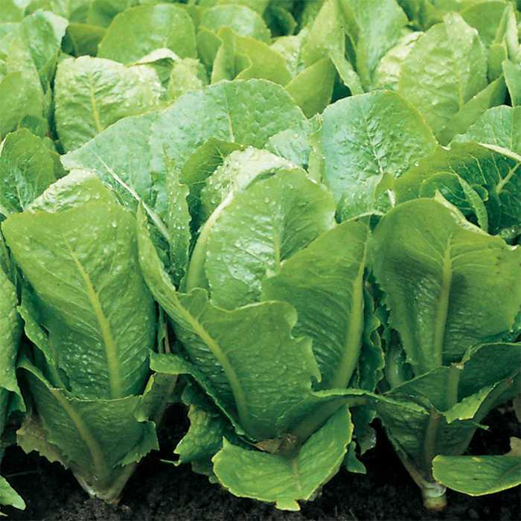
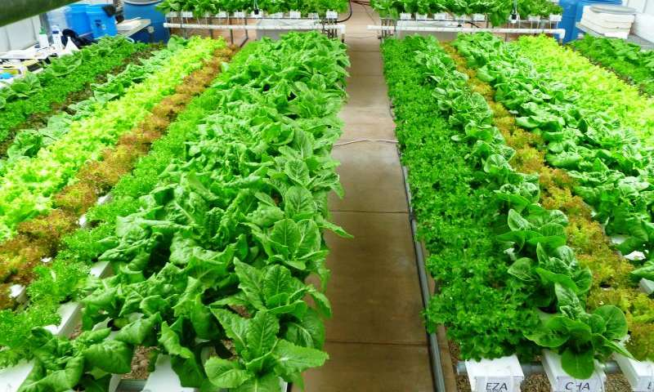
Tahoe Fruit & Vegetable Workshop Series Lettuce & Kale
Growing Lettuce
Planting
Early spring lettuce in Tahoe, sow indoors in late winter in or cold frames
After last chance for snow and ground is workable, plant seedlings or to extend harvest plant seeds directly in ground at weekly intervals ~ late May early June
As weather warms, plant or seed in shadier locations, use shade cloth
Limited space, lettuce can be intercropped with slower-growing or after harvesting other vegetables
Jungseed image
Texas A&M AgriLife Research photo
Notes:
For very early spring lettuce, sow heading types outdoors in mid-autumn in cold frames or under hot caps. (Try cutting out the bottoms of one-gallon plastic milk jugs, and set these, with the caps removed, over the young plants.) In mild climates, a very heavy mulch might be adequate to protect the plants from the cold.

Slide 28
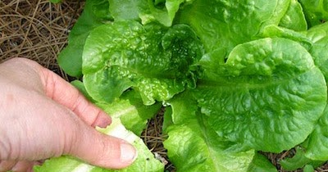
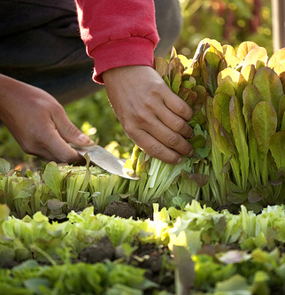
Tahoe Fruit & Vegetable Workshop Series Lettuce & Kale
Growing Lettuce
Harvest
Quality deteriorates, harvest ASAP
Make extra plantings not extend harvest
Pick in morning, preserves crispness acquired overnight
Loose-leaf can be harvested continuously
Head types test firmness with back of hand
My-Favorite Things image
Mad About Gardening image
Notes:
The quality of mature plants deteriorates quickly if lettuce is not used at its prime, so make extra plantings rather than trying to extend a harvest. To test the firmness of heading types, press down gently on the heart of the lettuce with the back of your hand. Don’t pinch it, as this can bruise the heart. Picking lettuce in the early morning preserves the crispness it acquires overnight. Use a sharp knife to cut the heads just below the lowest leaves or pull the plants out by the roots. For the best flavor and nutrition, use lettuce immediately. If that’s not possible, wash it thoroughly but briefly in cold water, and drain it well. Refrigerated, most lettuce will keep for up to two weeks.
As mentioned, loose-leaf lettuce can be harvested many times if only the lower leaves are picked and pinching off the top center of the plant will discourage it from bolting. There will be a subtle elongation of the plant just as it begins to bolt. At that point, it will start to form a bitter white sap. Should any plants start to go to seed, pull up and discard them — unless, of course, you’re a seed-saver. In that case, choose the last plants to bolt, as quickness to bolt is a bad trait. Also remember that any lettuce can cross with other varieties as well as with wild lettuce.
And don’t think of lettuce as just a salad ingredient. It can be lightly steamed, baked, or used in soups.
After you pick the outer leaves, allow the crown to grow for another week. By that time the spiral will have grown out even more and the new crown leaves from before will be the outer leaves. This cycle continues for a few weeks depending on the variety. By picking this way you can also stop the plant from bolting as quickly as it would with other picking techniques.

Slide 29
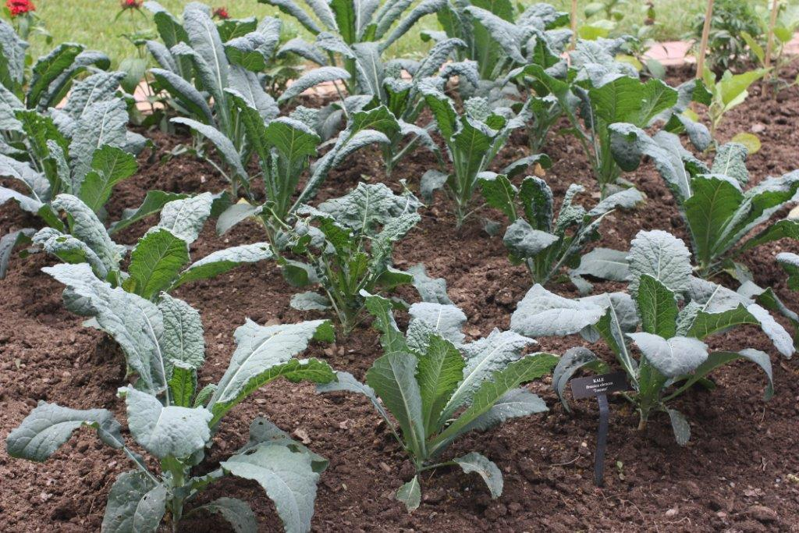
Tahoe Fruit & Vegetable Workshop Series Lettuce & Kale
Growing Kale
Prefers cool temperatures
Tolerates frost and snow
Requirements
Well-drained, light soil
Ample nitrogen, heavy feeders
- manure & compost
Soil pH 5.5 -6.8
4-8 hours sun
Water 3-5 days
Notes:
Kales can be started from seed in place now for a winter harvest; or set out as starts for earlier results. The seeds are vigorous sprouters, springing from the ground at a radish-like rate. You may want to thin the seedlings, because kales are large plants and need 12” – 18” between plants, in rows 18” apart. Provide ample nitrogen in the early growth stages, as kales are heavy feeders – alfalfa hay is a great nitrogen source and does a good job of mulching, as well. Once your kale has germinated, you should be able to harvest your leaves in 65-75 days. The lower leaves can be cut as early as 30 days for use raw in a salad. As the plant matures, pick the lower leaves when they are from 5”-8” long.

Slide 30
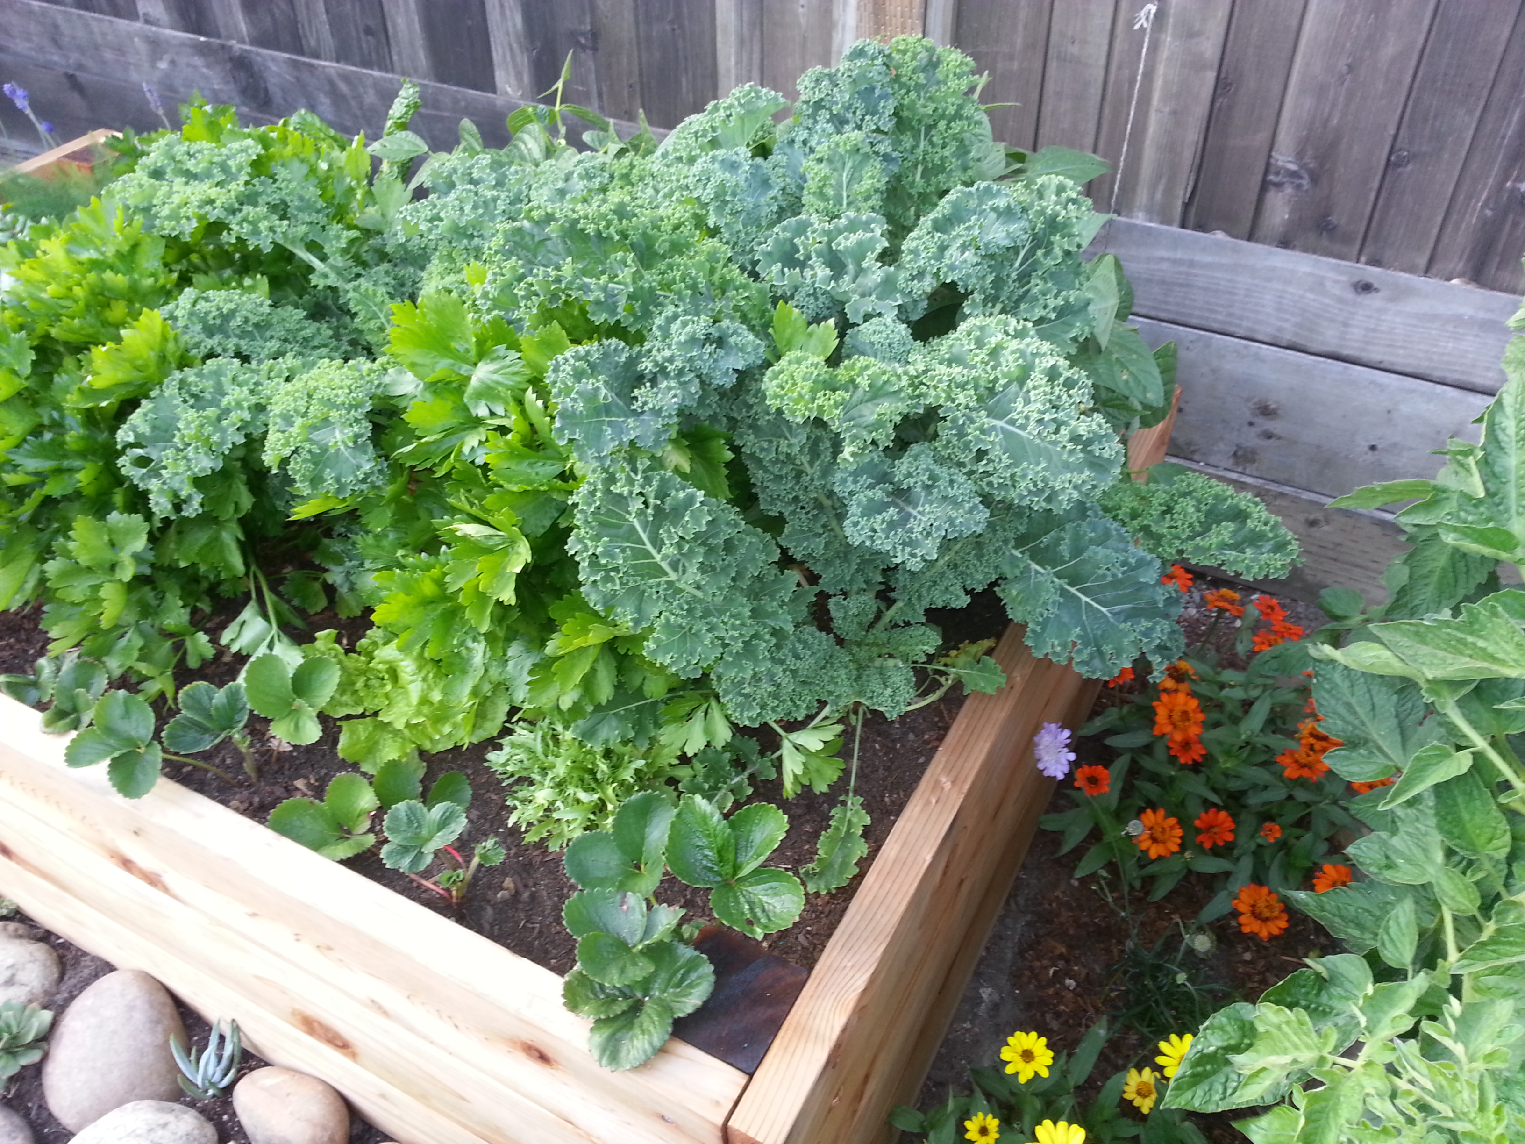
Tahoe Fruit & Vegetable Workshop Series Lettuce & Kale
Growing Kale
Planting
Early spring kale in Tahoe, sow late winter indoors or cold frames
After last chance for snow and ground is workable, plant seedlings 12 to 18 inches apart, closer for dwarf varieties
Toni Sicola image

Slide 31
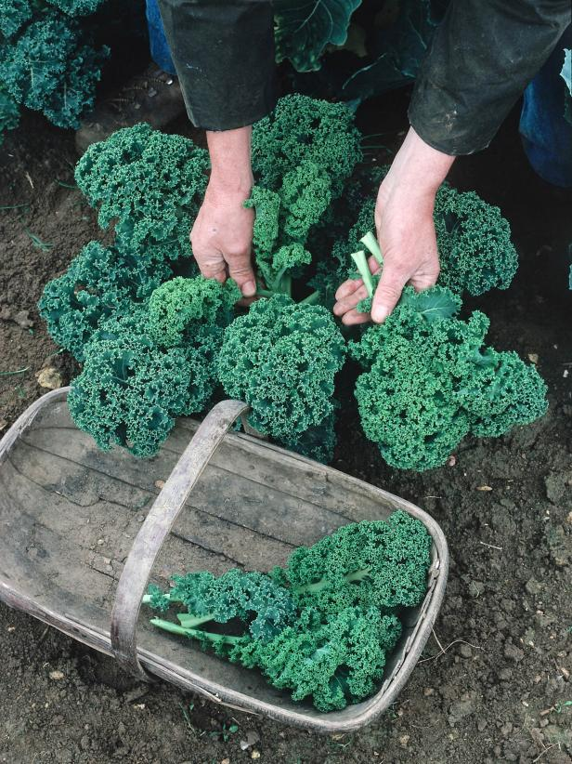
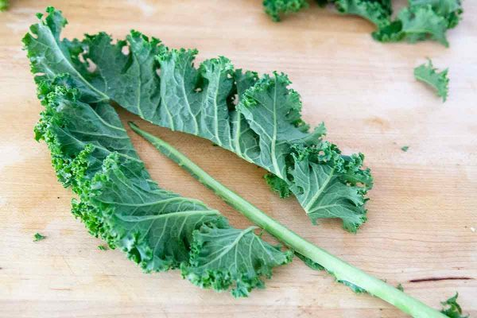
Tahoe Fruit & Vegetable Workshop Series Lettuce & Kale
Growing Kale
Harvest
Harvest leaves from bottom
cutting center will stop growth
Harvest in morning and refrigerate immediately
Kale becomes sweeter after first frost
Continues to grow in year 2
Dorling Kindersley

Slide 32
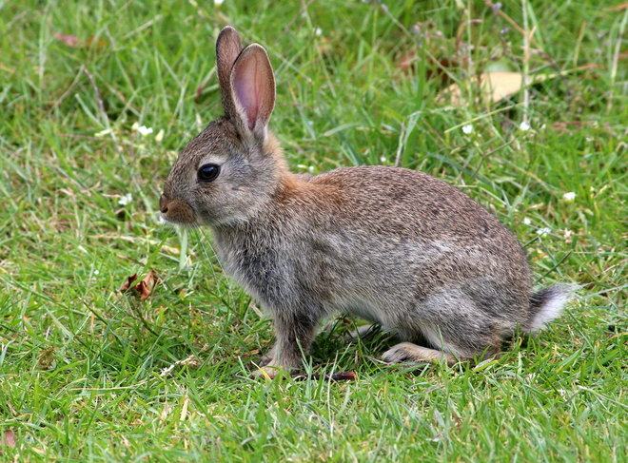
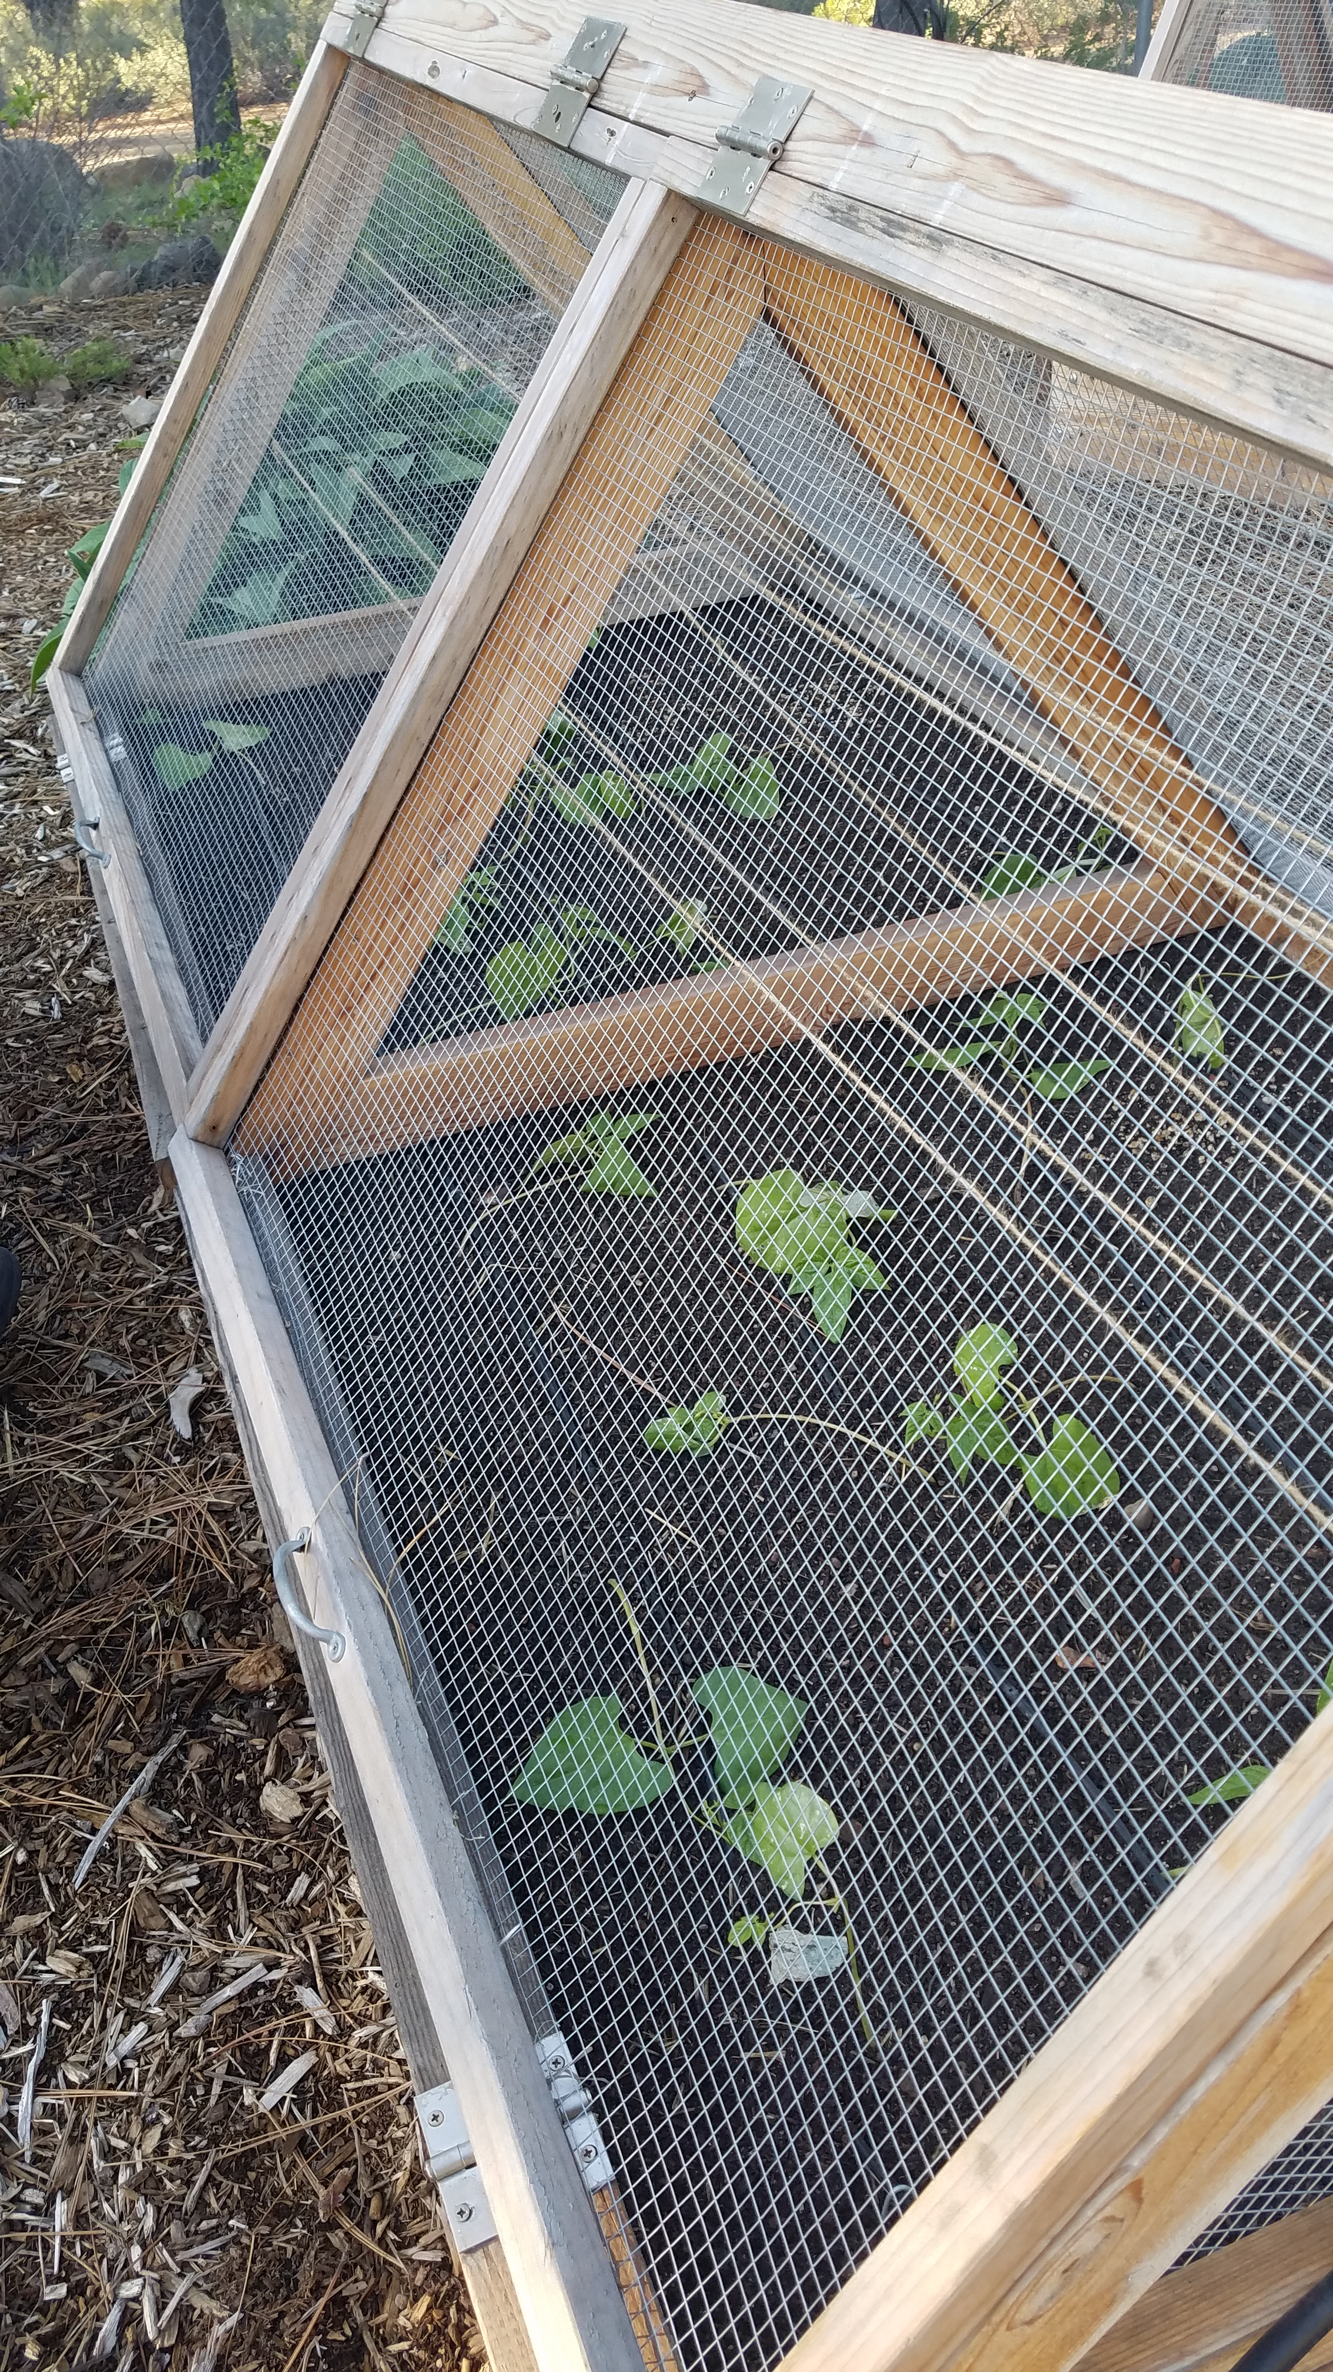
Tahoe Fruit & Vegetable Workshop Series Lettuce & Kale
Pests
Aphids
Slugs
Insect
Earwigs
Cutworms
Whiteflies
Critters
Squirrels
Rabbits
Birds
Diseases
Rot
Critters
Notes:
Pests of lettuce and kale are similar, but some are more likely on one or the other.
There are a number of insects and diseases that can attack lettuce, but if you plant in a rich, well-drained soil and keep your lettuce weed-free, you’ll seldom encounter serious problems in the lettuce patch.
I have found among the most common pests in my SLT garden are aphids and white flies and of course the critters. The best way to eliminate the insects is to wash them off, especially the aphids or a soap and oil spray. For critters the best solution is EXCLUSION. Wire mesh all around.

Slide 33
Tahoe Fruit & Vegetable Workshop Series Lettuce & Kale
Workshop Varieties
Lettuce
Black Seeded Simpson
Freckles Romaine
Kale
Lacinato
Dwarf Blue Curled Scotch

Slide 34
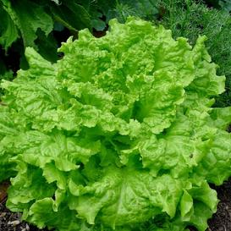
Tahoe Fruit & Vegetable Workshop Series Lettuce & Kale
Workshop Varieties
Black Seeded Simpson Lettuce
Favorite
Easy to grow
Strong yields
Notes:
Heirloom
An old time favorite, the Heirloom Black-Seeded Simpson is considered by many to be the #1 leaf lettuce variety. This variety is among the easiest of the leaf lettuce cultivars to grow, and it produces strong yields from seed. In addition to its delicious and complex taste, it is also a steady grower even in warmer climates.

Slide 35
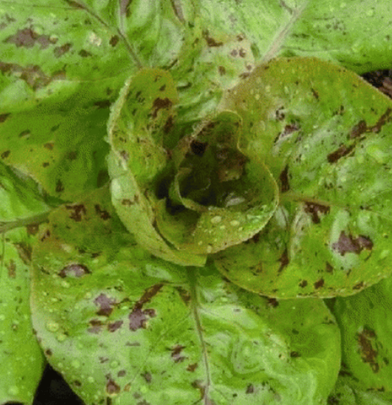
Tahoe Fruit & Vegetable Workshop Series Lettuce & Kale
Workshop Varieties
Freckles Romaine Lettuce
Heirloom
Splashes of brilliant crimson
Heat resistant, low bolt
German “specked like a trout’s back”
Notes:
Heirloom
Splashes of brilliant crimson on the leaves make this lettuce stand out. Very heat resistant, it usually will not bolt. Whether as baby or mature lettuce, this makes a show stopping addition to fresh salads.
Freckles heirloom lettuce, originally known by the German name of "Forellenschluss," which means "speckled like a trout's back," comes from Austria and Southern Germany in the late 18th century

Slide 36
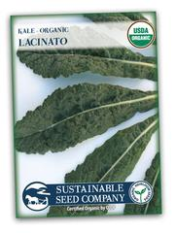
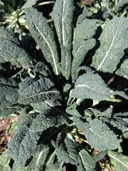
Tahoe Fruit & Vegetable Workshop Series Lettuce & Kale
Workshop Varieties
Lacinato Kale
Heirloom
30 days baby leaf
60 days full size
Aka Dinosaur kale
Fantastic Flavor
Italian heirloom
Notes:
Heirloom
30 days baby leaf, 60 days full size
Also known as Dinosaur kale An old Italian heirloom kale dating back to the eighteenth century.
Lacinato is a unique variety that produces blue-green, bumpy leaves that are 3-4" wide and 11-19" long.
Fantastic flavor that is enhanced by the first frost.
Enjoy Lacinato when the leaves are young and tender.

Slide 37
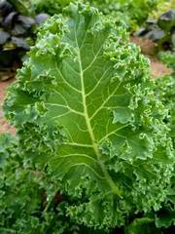
Tahoe Fruit & Vegetable Workshop Series Lettuce & Kale
Workshop Varieties
Dwarf Blue Curled Scotch Kale
Heirloom
Tasty salad or steamed
Hardy
Productive
Notes:
Heirloom
First mentioned in garden text around 1863. Dwarf Blue Curled Scotch is an early kale that produces tasty greens when used in salads or steamed. The blue-green leaves are finely curled and very attractive, reaching 12-15" in height, and spreading to 20-35" in width. Extremely hardy and productive. Will over winter with little protection. This is one of the best frost resistant kales.

Slide 38
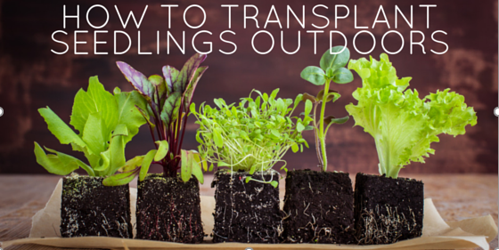
Tahoe Fruit & Vegetable Workshop Series Lettuce & Kale
Harden off the seedlings - adjust to sun, wind and temperature
Dig a hold slightly larger than the pot size
Gently remove the plants – those roots are tender
Space to allow for mature growth
Plant just at the crown, if not stems rot
Fertilize with a well balanced fertilizer or compost, leafy veg need a good source of nitrogen
Notes:
Gently support the plants and turn the pot upside down. Then squeezing the sides at the same time you push the bottom of the pot your seedlings should slide out like a charm. Resist the urge to disturb the root system by crumbling the “dirt block” in your hands! Simply transplant the seedlings into the soil right below the leaves.
Lettuce plants thrive in nutrient-rich soil. Once the seedlings emerge, a dose of fertilizer can be applied to maximize lettuce leaf production. Choose a well-balanced fertilizer with equal parts nitrogen, potassium and phosphate. If using a granular type fertilizer, look for 10-10-10 or 5-5-5 mixtures.

Slide 39
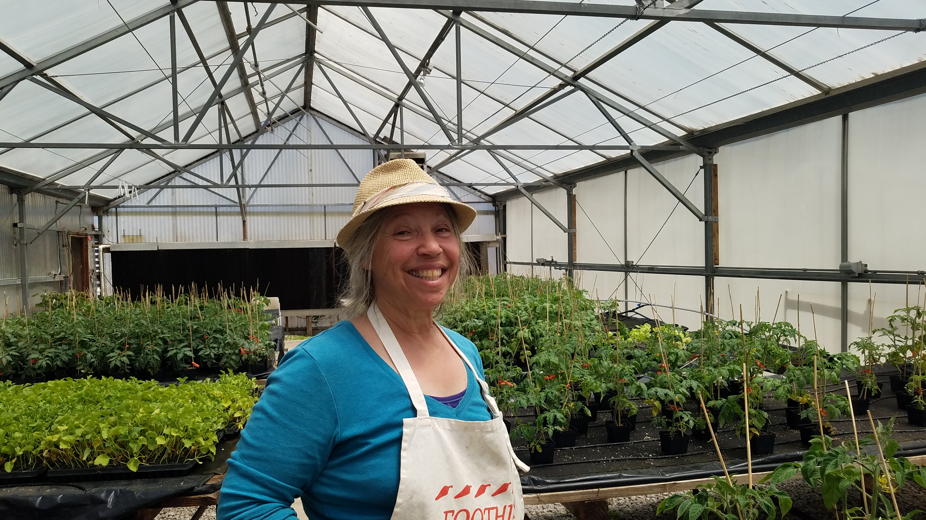
Tahoe Fruit & Vegetable Workshop Series Lettuce & Kale
Lettuce plants grown by . . . .
Jeanne Fry, Volunteer the UNR High Desert Farming Initiative. The program supports small farmers in identifying and growing higher value crops in western Nevada.
The Tahoe Master Gardener vegetable growing workshops qualified for participation – Looking at high elevation issues of food production.
Notes:
Thank you for growing the lettuce for our workshop.

Slide 40
Tahoe Fruit & Vegetable Workshop Series Lettuce & Kale
Kale plants grown by . . . .
The University of California, Davis, Tahoe Environmental Research Center (TERC), has monitored Lake Tahoe for over 50 years, amassing a unique record of change for one of the world’s most beautiful yet vulnerable lakes.
Public tours are available at the Tahoe City Field Station in the summer and year-round at the Tahoe Science Center in Incline Village.
Alison Toy
Bre Harris
Notes:
Alison is also a trained Master Gardener
Thank you for growing the kale for our workshop.

Slide 41
Tahoe Fruit & Vegetable Workshop Series Lettuce & Kale
Distribution of Plant Materials
2 pony packs TOTAL, 12 plants
1 pack lettuce, 2 varieties
1 pack kale, 2 varieties

Slide 42
Tahoe Fruit & Vegetable Workshop Series Lettuce & Kale
Ornamental Kale
Notes:
I thought I would leave you a collage of ornamental kale and hopefully entice you to grow some in your garden. Before conducting my research to create this presentation, I had no idea the broad varieties of ornamental kale. But it make sense Brassica oleracea has been breed for millennia to create all the brassica vegetables. I plan to grow some ornamental kale this year.

