Slide 2
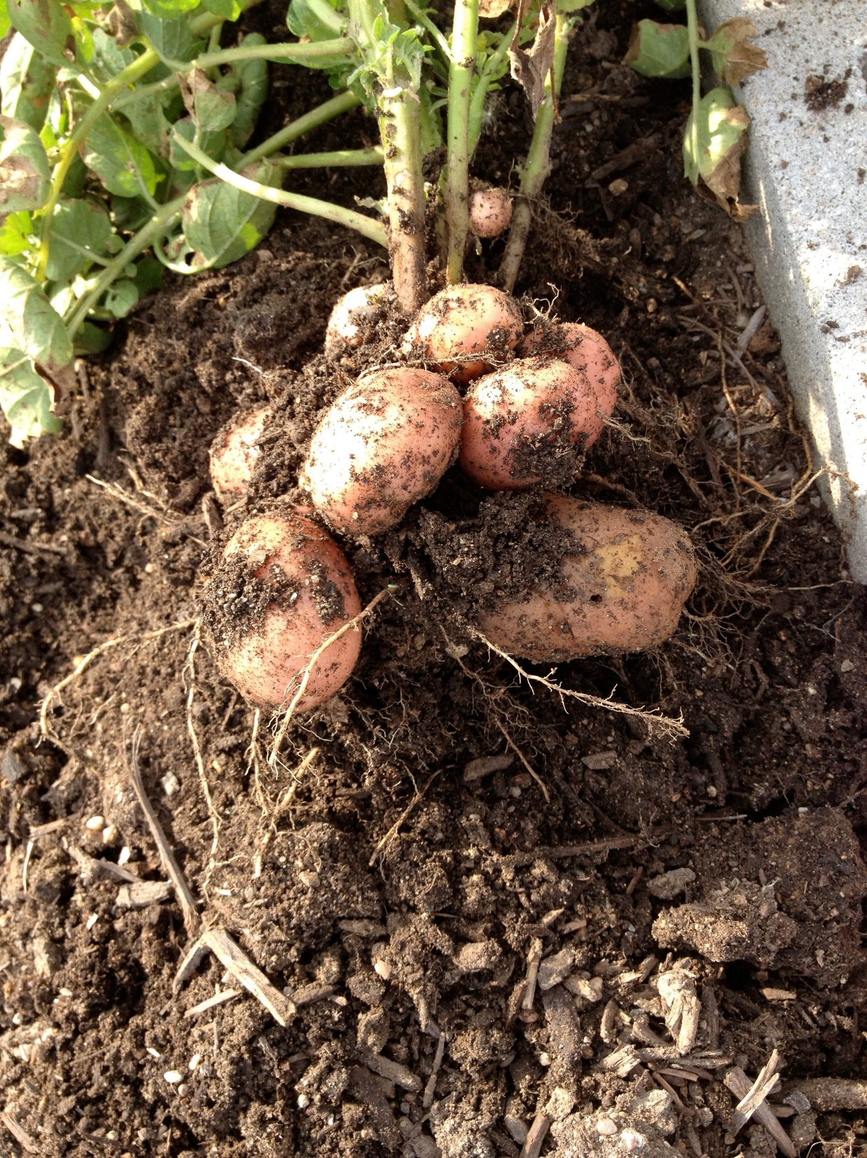
POTATOES
Growing in TAHOE is Easy
by
Melissa Guthrie

Slide 3
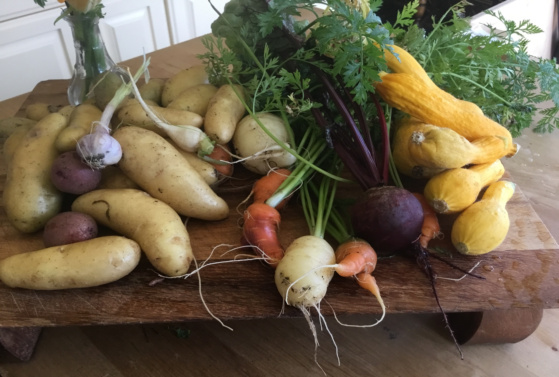
It is very easy to grow potatoes in Tahoe, given the right conditions
Well drained organically rich soil is the best. Acidic with a pH of 4.8-6.5, high in potassium and nitrogen. Growing season is after frost (unless you have a green house or warm, sunny sheltered area . At 45 degrees or more, planting area is optimal.
Well drained organically rich soil. Acidic soil with a pH of 4.8-6.5 Measurement tools available, high in potassium and nitrogen. Yes, I'm reiterating.

Slide 4
Planting early in spring, one pound of seed potatoes can yield approximately 25 pounds of home grown spuds that can last all winter.
I encourage you to just try!
Local Master gardeners are always a good resource for questions about your spud plants.

Slide 5
The first domesticated potatoes were grown at a High Elevation in the Andes in 8000 BC. They are plants that store for long periods of time, provide sustenance and are as much fun to plant, enjoy as just foliage, then dig and eat. Why potatoes in Tahoe? Elevation and acidic soil are an advantage in our little area of paradise. There is a reason the first potatoes were grown in Peru and Bolivia. They are easy to grow, thrive at elevation, store for months and are high in nutrients. Elevation not to be confused with altitude, unless you are growing in an airplane. That will be explored next year due to budgetary constraints.

Slide 7
NUTRITION & usda POTATOES ARE RICH SOURCES OF……. POTASIUM, K+ (more than a banana), heart and muscle health…super important VITAMIN C (NO SCURVY and less COLDS) ASCORBIC ACID helps healing CALCIUM Ca+ (bones and cardiac function), hello osteoporosis. I’ll pass. IRON Fe (muscles, blood cells, energy) PROTEIN (building blocks of cells and ATP), captive energy a rebuilder of cells B6 (B vits promote everything and are crucial in cognitive and organ protective) fiber, fiber, fiber!!! Guts, colon, digestioin (2.2gm) in a 148gm (medium) potato A SOURCE OF HEALTHY CARBOHYDRATES, energy, 0 fat, 0 cholesterol, 0 salt (LEAVE OFF THE BUTTER)! Even without the extras they are so good with just lemon and pepper. EASY TO GROW, INEXPENSIVE, NUTRIOUS, REWARDING FOR KIDS TO PLANT AND HARVEST, potatoes are.. AND WAIT FOR IT………GLUTEN FREE!

Slide 8
1589 Sir Walter Raleigh first brought potatoes to Europe from South America, shared some with Queen Elisabeth and planted them in his home town of Cork. They did well and became a staple.
According to the Smithsonian, potatoes gave way to modern industrial agriculture. There are currently over 4 thousand varieties. China is noted as the largest grower and consumer of potatoes and potato based products.

Slide 9
The Start: Seed potatoes
When potatoes sprout, their natural starch begins to convert to sugar and they will start to shrivel, not good. FIRM sprouted “eyed or chitted” potatoes can be cut into pieces that have a sprout or two. They will then start to spend their energy producing new spuds. Harvest size potatoes are safe to eat if firm, not green and should be free of pest and disease damage. At this point Potatoes are the most nutrient dense.. Mushy or shriveled seed potatoes will not be bumper crops nor will they become tasty to eat. Remove all the sprouts and green, or discard green ones, before cooking.

Slide 10
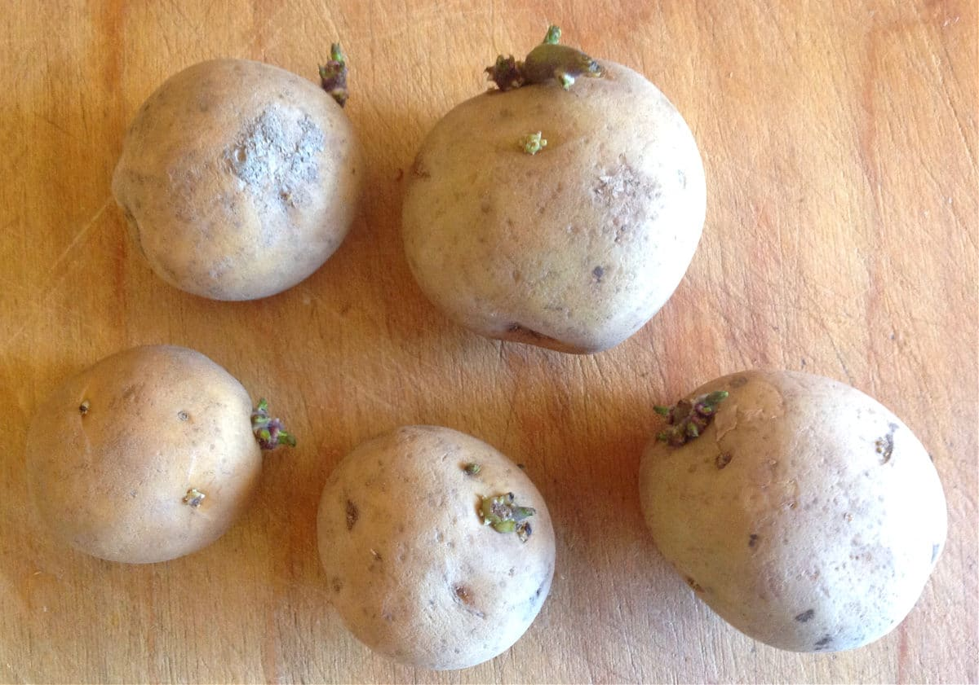
Stages of growth & planting
First, amend the soil if it is poor or clay and drainage is bad, add compost or decomposed matter. Place cut spuds with at least 1-2 “eyes”, 2- 3” down, 10-12” apart. Cover loosely with rich well drainable soil (don’t stress, potatoes are forgiving). While the grow, if potatoes are visible at soil level, cover or “hill-up” to make sure they are under the dirt so that they don’t go green. You can continue this throughout growing season and before harvest.

Slide 11
Green indicates the toxic and poisonous chemical ‘Solanine’ a nightshade species toxin which occurs naturally in tubers when exposed to sunlight and can cause gastrointestinal distress. (stomach-ache).
NO Green Potatoes(again)……..!!!!! Cut that part off or discard the green spud entirely.

Slide 12
Second stage is beautiful green leaves and plants can reach 1-2 feet plus is the benefit of white or purple flowers.
Third stage is that the foliage starts to look like its dying….good, let the plants be and don’t water for 5-7 days. The potatoes are then harvestable!
Take pictures, make your friends envious and they might even try next year.

Slide 13
Why cant you just use commercial market potatoes? Good question!
Grocery store potatoes are often treated with a chemical CHLOROPROPHAM (CIPC) which interferes with cell division and is most commonly used post-harvest in the US. It is non-organic.
Organic stinky options to prevent unwanted sprouting are:
Clove oil
Spearmint and/or peppermint oil
Oregano oil
And……..hydrogen peroxide (yuck)
Or, buy seed potatoes from a good source. You can also store last years tiny ones in a breathable bag in the back of your refrigerator.

Slide 14
Major Potato Diseases, Insects and Nasty leaf-eating rodents. (USDA/research Service & CID La Papa)002408.pdf
Bacterial: Common Scab, Ring Rot, Blackleg Rot, Bacterial wilt. Pectobacterium
Fungi: Blight (see picture) over wintering and bad/undigested soil, Powder Scab & mildew, Verticillium Wilt (yellow droopy, caused by poor crop rotation) Stem & Black Rot, Andean Weevils. Plus a bunch more. http://cipotato.org//librarypdfdocs
Nematode(most difficult): Cyst, Root, False-knot and lesions are the most noticeable. Crop rotation/cover crops, nematode-free & certified seed can indirectly reduce infestation damage with soil enhancements. See Review article ‘Organic amendments of soil as useful tools of plant parasitic nematode control’ at www.researchgate.net 11/2012 potato nematodes.
Insects: Aphids(green peach/potato) …best get hungry lady bugs or plant mustard. They are both effective. You can also use a pesticide like IMIDCLOOPRID but pesticides will harm bees around any flowering plants, so don’t.
Rodents: voles, ground squirrels, mice & birds. Cayenne pepper, mashed garlic, diluted dish detergent and high pressure water spray work well and wont harm the animals, bees or the environment. Spray leaves & repeat every week or so. www.Eartheasy.com .
Notes:
Ptato.org/library/pdfdoc

Slide 15
No matter how bad the spuds look, plant the firm ones ANYWAY. Potatoes should sprout and the plants alone are pretty producing flowers and lovely leaves. Some main stream grocery store varieties will not produce potatoes due to application of industrial anti-sprout inhibitors BUT will grow annual foliage that can be beneficial to other plants and rotating crops.
Cut vs. whole...up to you. I have never had a problem with the cut pieces and you can store the tiny whole ones for next year.

Slide 16
Keep in mind, it is important that you rotate potato crops yearly for soil health and nutrient replenishing. I keep a garden journal with pictures. Potatoes can spread host fungi that cause Fusarium and Verticillium wilt. Both can be spread through soil with successive plantings of potatoes and after eggplant, peppers or tomatoes (solanaceous crops). They are all in the nightshade family and draw similar soil nutrients but most importantly, can spread diseases. Avoid root crops after potatoes. A good basic rotation is .. Roots (potatoes, turnips, beets, carrots), greens(cabbage to lettuce), fruits(tomatoes, peppers, squash, cucumber), then beans and peas. This type of rotation reduces soil depletion, reduces need for added amendment and risk of opportunistic diseases. Remember the journal! Plant leafy greens after potatoes! Or RGFB (sounds like a Punk club!)

Slide 17
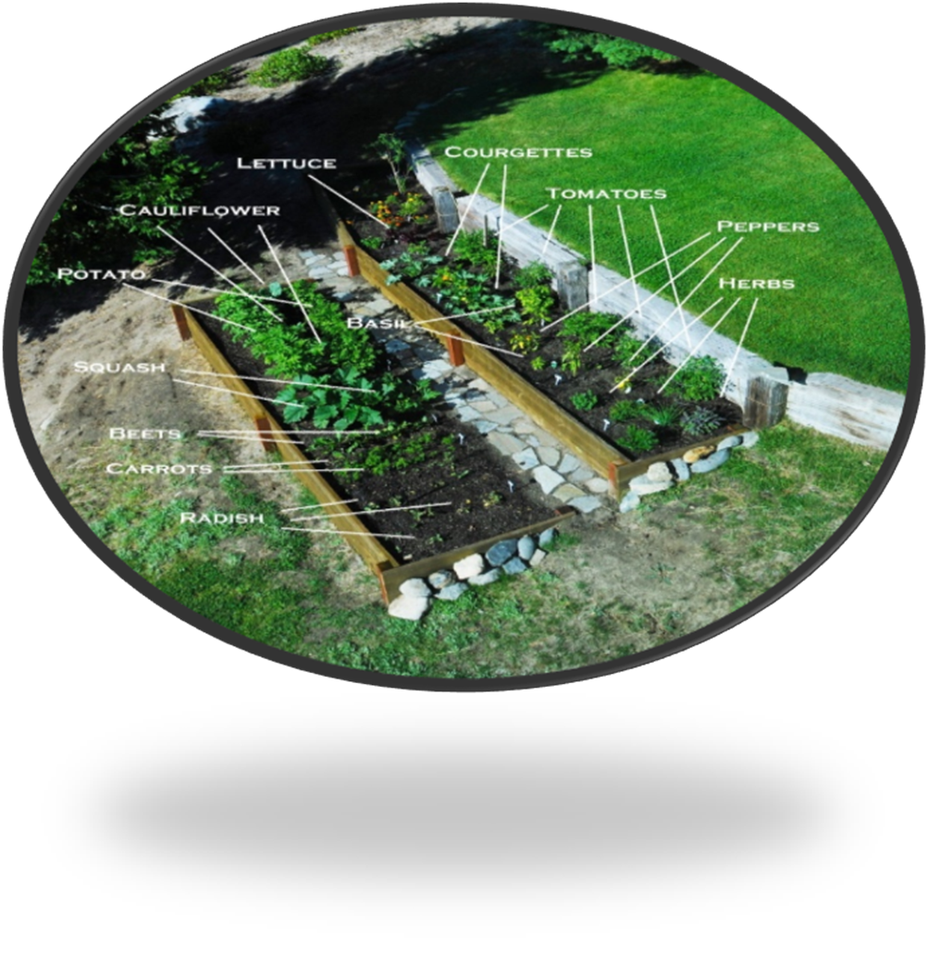

Slide 18
AT MASTER GARDENERS
We hope to demonstrate what types of planting options there are for gardens and what works well. It really depends on the space, time and amount you plan to cultivate. These are some of the many options:
Containers, bags
Raised beds
Garden rows
Hydroponic
We are providing grow bags this year with about 3” bottom soil, seed potatoes of your choice and then recommend covering with 3” soil and planting the bag with more soil added. Then hilling them up as they grow (add more soil). No spuds should ever be above soil as this can cause the toxic green parts when exposed to light.
South facing beds get the most sun.

Slide 19
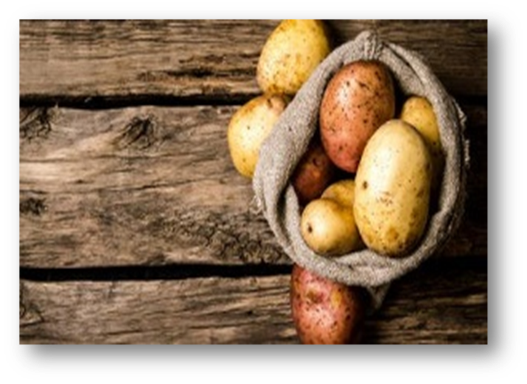
Notes:
The Farmers market potato grow bags are donated by our local Tahoe Trash/Recycle (Thank you Jeanne and Leo) department for potato growing. We also received 350 pounds of donated seed potatoes…. Lets grow Tahoe!

Slide 20
At this year’s Farmers Markets, (Master Gardeners) we will be giving out potatoes in grow bags kindly donated by Douglas Disposal & Recycling and potatoes from The Maine Potato Lady plus enough info to get you started. Bags are only to be used for potatoes and don’t just eat the potatoes!!! Please, GROW.
Notes:
The Farmers market potato grow bags are donated by our local Tahoe Trash/Recycle (Thank you Jeanne and Leo) department for potato growing. We also received 350 pounds of donated seed potatoes…. Lets grow Tahoe!

Slide 21
The Maine Potato Lady has supplied all of our potatoes! You can find her at www.mainepotatolady.com (20% off all in-stock spuds and onions) if you need more. She is located in Maine and the LaCourse Family Farm has been in operation for 25+ years. The farm is a piece of history that dates back to the 1600s. The potato fields are south facing and certified. This is a business that brings love to gardening. Please check out the website. WE are fortunate to have such great community support.

Slide 22
Harvest
This is where kids are your best friends. Little enthusiastic hands and small fingers make great potato harvesters. It’s dig in the dirt fun, plus a rewarding activity.
Potatoes grow up from the planted ‘seed’ potato and grow horizontally. Usually only about 12-16” down and 12-16” wide (but some will escape and will pop up within 2 feet of the initial plant the following year). Harvesting needs to be done gently, so as not to damage the potatoes because the new skins have to cure or air dry for a day or so, out of and on the dirt. This prevents rot and hardens the skin for storage.

Slide 23
Harvest
They are still alive when picked so I do not recommend shovels or pitchforks.. After drying, your harvested potatoes should be stored in a cool dark place to prevent sprouting. If you have a cave, cellar or ‘potato’ closet go for it but, I put them in a breathable bag and toss into the back bin of the fridge. They usually last until January or Feb.

Slide 24
Late Summer Potato Salad (warm or chilled) Side dish or vegetarian/vegan main, super simple and adaptable 1.5 Lb. small home-grown potatoes, halved 1 bunch home grown chives or red onion, minced 1 Tbsp. chopped capers( or sub/add anything from your garden pickled and chopped) 1-2 Tbsps. grainy mustard olive oil Salt and pepper olive oil (Carrots or peppers from garden, minced, optional) Par-boil potatoes, then sauté with olive oil , flat side down until crispy, golden brown. Cool just to warm. Stir in herbs, grainy mustard, salt + pepper and & a douse of olive oil (or walnut, Avocado or ghee). Gently toss and serve. *You can add any other veg, meat or herbs or seasoning to make it your own and its always better the next day. coo

Slide 25
Dirty hands are good! (washed after of course)……grown potatoes make wonderful meals, healthy eating and happy hearts. The plant-tend-harvest cycle is so nourishing on many levels. Plus, if you ever end up stranded on Mars…you’re all set. (Just ask Matt Damon). Now THAT’S High-Altitude growing!!
Notes:
“The Martian” movie, just omit the poop.
Pontiac red,German butter ball, yellow fin, sullanita, La Rouge, French fingerling Humbolt Red,

Slide 26
We would love to field any questions and hear back on how well you did. Please share stories and pictures and ask questions at http://ucnar.edu/sites/mglaketahoe/

Slide 27
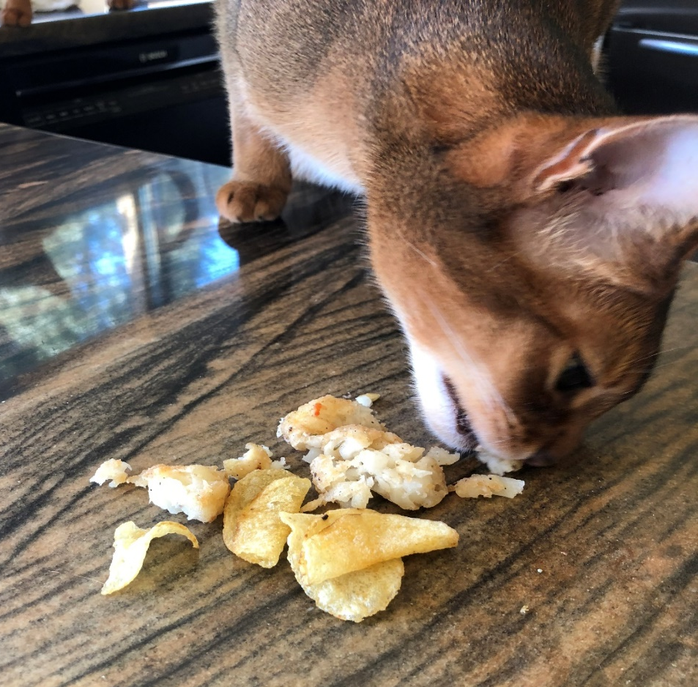
Without opposable thumbs, CATS can’t grow potatoes but they are enthusiastic consumers!
Notes:
This is Jack my 3 year old Abyssinian….he also loves blueberries.

Slide 28
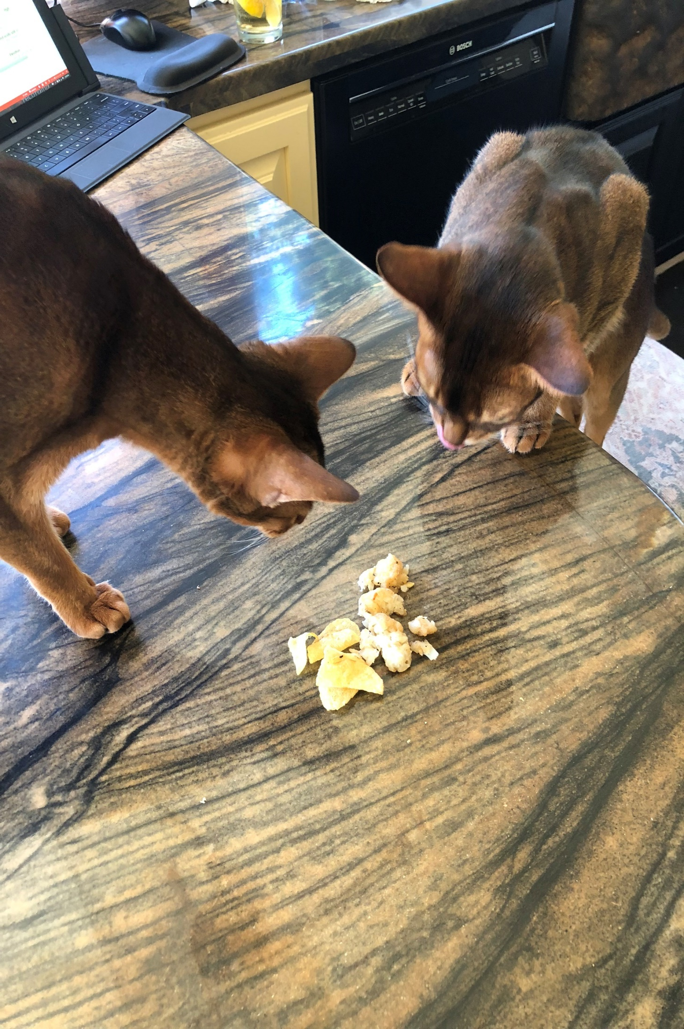
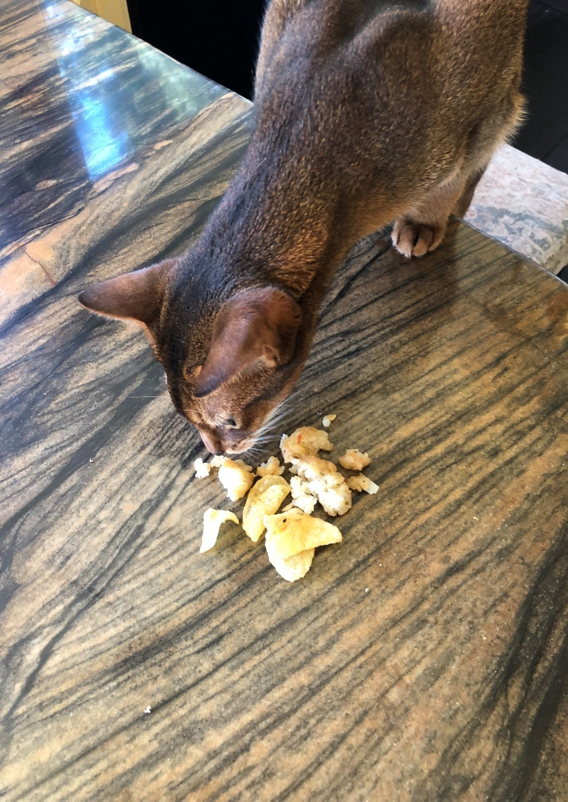

Slide 29
I may look like a potato now... but one day I’ll turn into fries and you’ll ALL want me then

