Slide 1
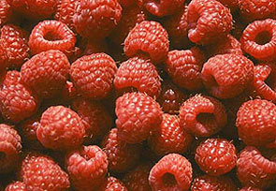
Tahoe Fruit & Vegetable Workshop Series
Raspberries and a Gooseberry
Not this kind of Raspberry
This kind of Raspberry
Krieger’s Wholesale Nursery Image
Charles Schultz Image
Co-operative Extension Tahoe Basin Master Gardeners

Slide 2
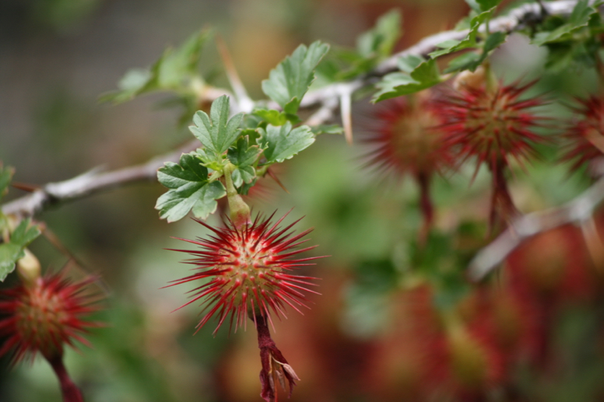
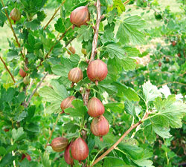
Tahoe Fruit & Vegetable Workshop Series
Raspberries and a Gooseberry
Maybe not this Gooseberry
Ok maybe this Gooseberry
Truckee River Guide Image
University of Wisconsin Image
Co-operative Extension Tahoe Basin Master Gardeners

Slide 3
Tahoe Fruit & Vegetable Workshop Series
Raspberries and a Gooseberry
Who we are
Master Gardeners are community members who have been trained under the direction of the University of California (Davis) Cooperative Extension.
50 hours of formal classroom training
We assist the UC Cooperative Extension by providing practical, scientific gardening information to the home gardeners in the Lake Tahoe Basin.
The Lake Tahoe Master Gardeners offer research-based information by:
Answering questions via email hotlines, farmers markets and events.
Offering workshops and classes
Co-operative Extension Tahoe Basin Master Gardeners

Slide 4
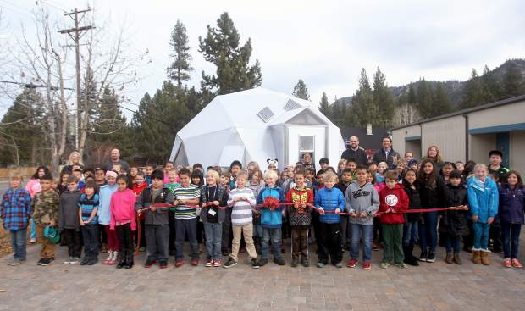
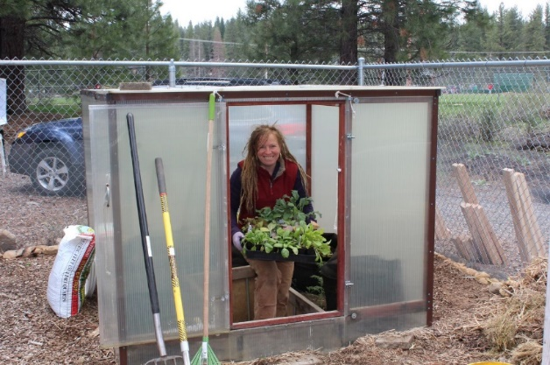
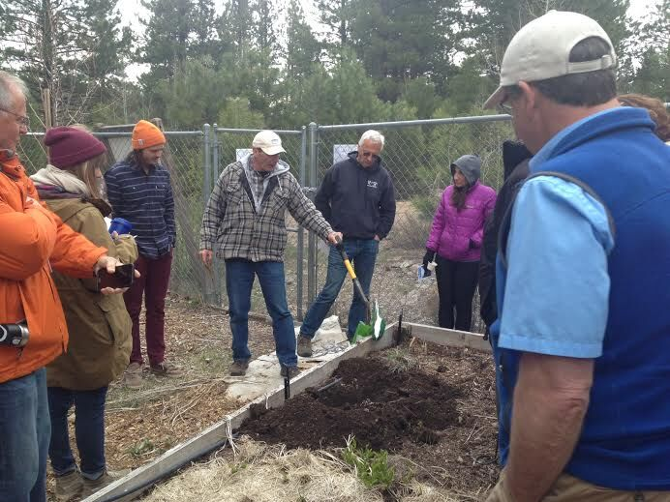
Tahoe Fruit & Vegetable Workshop Series
Raspberries and a Gooseberry
Master Gardeners
Work with School Gardens
Do workshops
Work with Community Gardens
Co-operative Extension Tahoe Basin Master Gardeners

Slide 5
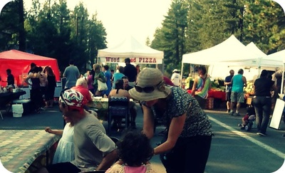
Tahoe Fruit & Vegetable Workshop Series
Raspberries and a Gooseberry
Answer Basic Gardening questions at Farmers’ Markets
Plant Sales
Most common answer to any question:
It depends?
Co-operative Extension Tahoe Basin Master Gardeners

Slide 6
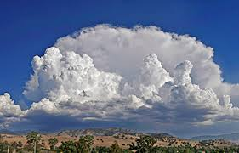
Tahoe Fruit & Vegetable Workshop Series
Raspberries and a Gooseberry
Phenology
Phenology looks at growth and development differences between plant varieties that are due to weather and climate.
Merriam-Webster on-line Dictionary
Varietal Comparative Phenology (VCP) compares growth and development differences between plant cultivars that are due to weather and climate
Co-operative Extension Tahoe Basin Master Gardeners

Slide 7
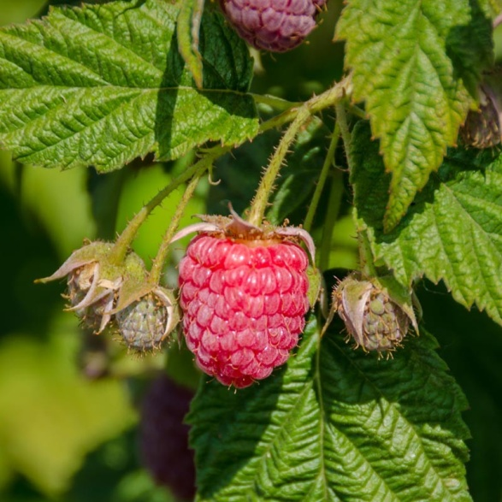
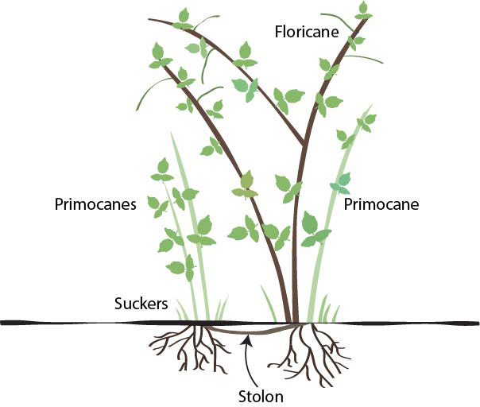
Tahoe Fruit & Vegetable Workshop Series
Raspberries and a Gooseberry
Raspberry anatomy
The fruit are borne on short racemes. Botanically not a true berry but an aggregate of druplets
around a conical core.
Grow Organic Image
The crown of a raspberry plant will live about 10 years
University of Minnesota Image
Co-operative Extension Tahoe Basin Master Gardeners

Slide 8
Tahoe Fruit & Vegetable Workshop Series
Raspberries and a Gooseberry
What’s in a name?
Raspberries and closely related blackberry, tayberry boysenberry, loganberry, and dewberry are referred to as brambles (at least those with a spreading habit).
Batology – The scientific study of the genus Rubus, specifically those in with spreading appearance
Batologist is a person that studies brambles
Raspberry name is derived from either –
raspise (sweet red wine) - 15th century English concoction
vinum raseys (rough vines) - Anglo Latin
raspoie (thicket) - Germanic
rough berry - Old English
Co-operative Extension Tahoe Basin Master Gardeners

Slide 9
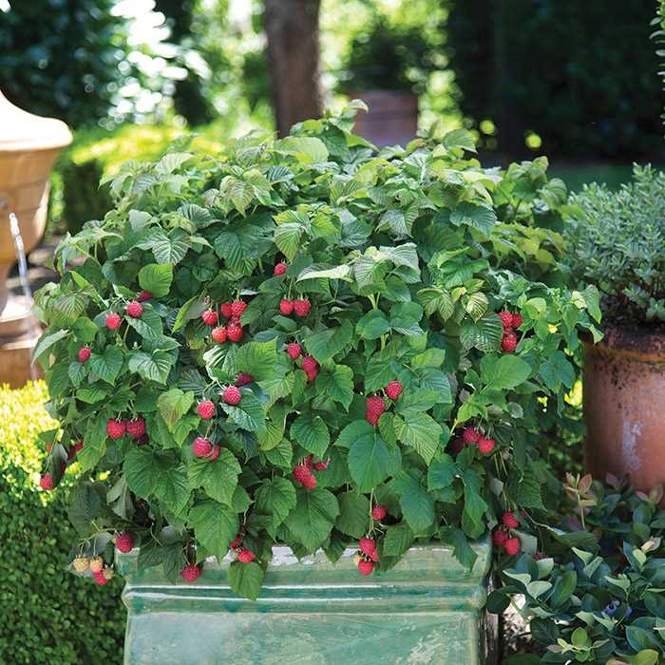
Tahoe Fruit & Vegetable Workshop Series
Raspberries
A Rose is a Rose
Raspberries are in the rose family (Rosaceae. The genus name is Rubus. The red variety is R. Idaeus, and the North American subspecies is spp strigosus.
The black raspberry or black cap is native to North America, R. occidentalis.
The yellow raspberry are red varieties with a gene for red pigment missing.
The purple raspberry is a cross of red and black cultivars.
Jung Seed Image
Co-operative Extension Tahoe Basin Master Gardeners

Slide 10
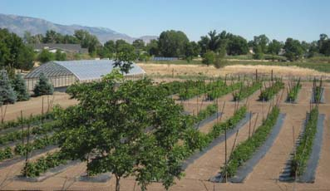
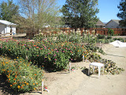
Tahoe Fruit & Vegetable Workshop Series
Raspberries and a Gooseberry
Tips and Assistance
Desert Farming Initiative (with Cooperation of Jacobs Family Farm)
Raspberry and Blackberry Maintenance Guide
http://farmnevada.org/raspberry-and-blackberry-maintenance-guide/
Jacobs family Farm Images
Co-operative Extension Tahoe Basin Master Gardeners

Slide 11
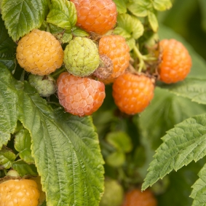
Tahoe Fruit & Vegetable Workshop Series
Raspberries
Desert Farming Initiative (with Cooperation of Jacobs Family Farm)
Raspberry and Blackberry Maintenance Guide
http://farmnevada.org/raspberry-and-blackberry-maintenance-guide/
The guide provides step by step instruction for maintaining established black and red raspberry plants. Treat the Fall Gold as a red floricane.
Monrovia Nursery Image
Co-operative Extension Tahoe Basin Master Gardeners

Slide 12
Tahoe Fruit & Vegetable Workshop Series
Raspberries and a Gooseberry
Raspberry production
Russia is the worlds leader in raspberry production 21%
The US is second at 17%
Poland produces 16%
Mexico about 14%
Faostat – United Nations
Krieger Nursery Image
Co-operative Extension Tahoe Basin Master Gardeners

Slide 13
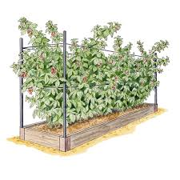
Tahoe Fruit & Vegetable Workshop Series
Raspberries
Selecting and preparing your planting area
Select a sunny area, hopefully out of wind
Area should not have grown tomatoes, potatoes , or roses for at least a year
Soil should be fertile having some organic materials incorporated with good drainage
Raised beds or containers (7+ gallons) can be used
5. Berry plants will need support so plan on a trellis, or other support system
6. Consider planting through a weed barrier with mulch placed to maintain rows
Gardeners.com Image
Co-operative Extension Tahoe Basin Master Gardeners

Slide 14
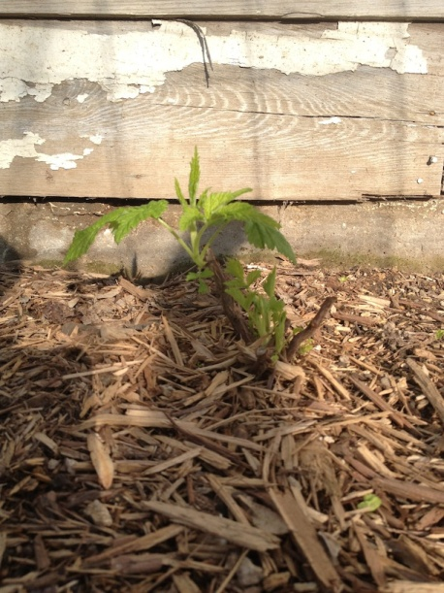
Tahoe Fruit & Vegetable Workshop Series
Raspberries
Planting instructions
1. Area should be free of weeds
2. Soak bare root plants in water for 1-2 hours before planting
3. Dig hole large enough to spread out roots.
4. Top of crown (first roots) should be 2-3 inches below surface
5. Tamp down soil around plants to have good soil contact
6. Plants of same variety should be spaced 18-24 inches apart
7. Plant different varieties at least 6 ft apart.
8. Plant black varieties away from other red/yellow cultivars
9. Water well immediately after planting, recheck soil depth
10. Trim all stems to about 3-5 inches
Stark Brothers Nursery Image
Co-operative Extension Tahoe Basin Master Gardeners

Slide 15
Tahoe Fruit & Vegetable Workshop Series
Raspberries and a Gooseberry
Maintaining your garden space
There is a tendency with new growers to let sucker plants develop wherever they appear.
It is recommended that suckering plants be removed or replanted into the row. This maximizes space utilization and makes harvesting easier. It makes trellising or supporting easier. And easier to place bird netting.
Co-operative Extension Tahoe Basin Master Gardeners

Slide 16
Tahoe Fruit & Vegetable Workshop Series
Raspberries and a Gooseberry
Primocanes and Floricanes
New growth, or first year shoots are called primocanes. The second year growth are floricanes. Flowers and fruit occur on floricanes (most varieties).
By topping (the cutting off the tip of a primocane stem) you can increase branching and flowers the second year.
Tip removal when primocane is 3-4 inches above your top trellis wire or not more than 48 inches
Co-operative Extension Tahoe Basin Master Gardeners

Slide 17
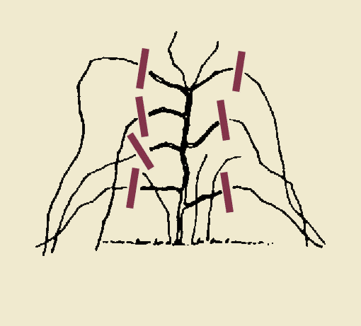
Tahoe Fruit & Vegetable Workshop Series
Raspberries
Pruning guidelines
1. Keep 3-6 of the most robust primocanes per crown. Remove the rest.
Top off the primocanes when the are about 6 inches taller than the top wire of trellis or about 48 inches.
Trim any side branches that develop on primocanes at 12 inches (Black raspberries).
4. Cut all floricanes to the ground following harvest.
5. It is recommended that you remove any flowers from the primocanes (Fall Gold).
Stark Bothers Nursery Image
Co-operative Extension Tahoe Basin Master Gardeners

Slide 18
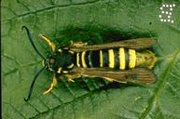
Tahoe Fruit & Vegetable Workshop Series
Raspberries
Pests and diseases
Aphids* Leaf Mosaic (virus)
Rabbits Bacterial Diseases (galls)
Powdery mildew Spider mites
Crown borer Anthracnose (rusts)
Birds
Chipmunks
Squirrels
Bears
Raspberry Crown Borer
Actually a moth but looks like a yellow jacket!
UC IPM Image
Co-operative Extension Tahoe Basin Master Gardeners

Slide 19
Tahoe Fruit & Vegetable Workshop Series
Raspberries and a Gooseberry
Nutrition (Raw 100 gm (3.5 oz.)
RDA
Calories 53
Carbohydrates 11,94 gm
Sugars 4.42gm
Dietary Fiber 6.5 gm
Fat 0.65 gm
Protein 1.2 gm
B1 0.032 mg 3%
B2 0.038 mg 3%
B3 Niacin 0.598 mg 4%
Folate 21 µg 5%
Vitamin C 26.2 mg 32%
Manganese 22 mg 32%
Water 85.8 gm
Co-operative Extension Tahoe Basin Master Gardeners

Slide 20
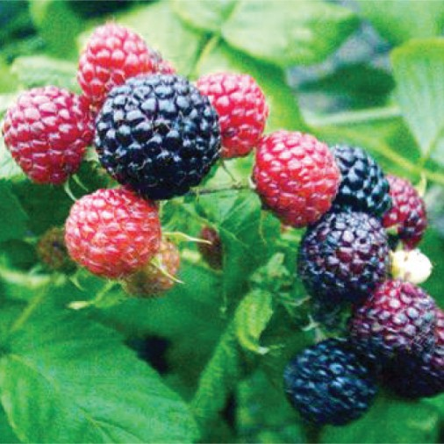
Tahoe Fruit & Vegetable Workshop Series
Raspberries and a Gooseberry
New Logan Black Raspberry
A floricane. This is an early season producer of small to medium sized fruit. Black Raspberries have a unique taste and more seeds than red varieties. the new Logan has a strong trailing habit, requiring aggressive pruning and trellising. Developed in the 1920s out of Illinois. Not as cold hardy as many red varieties.
Awald Farm Image
Co-operative Extension Tahoe Basin Master Gardeners

Slide 21
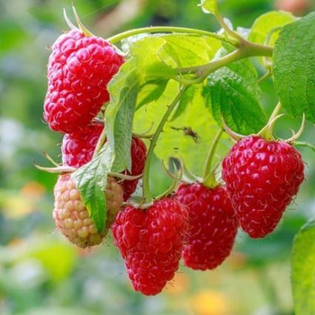
Tahoe Fruit & Vegetable Workshop Series
Raspberries and a Gooseberry
Latham Red Raspberry
A floricane. A very cold hardy variety with medium sized fruit. Consistent producer. Does well in a variety of soil types. Upright habit may require less support. Developed in 1914 at The Minnesota Experimental Station.
Nature Hill Nursery Image
Co-operative Extension Tahoe Basin Master Gardeners

Slide 22
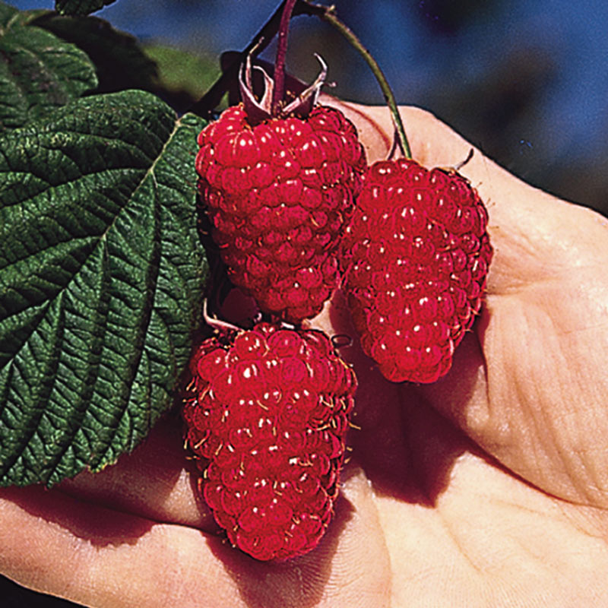
Tahoe Fruit & Vegetable Workshop Series
Raspberries and a Gooseberry
Mammoth Red Raspberry
A floricane. This variety a bit earlier than Latham. It produces very large fruit. The plants are nearly thornless, with fewer suckers developing. Sweet fruit does not freeze as well as Latham. Does well in soils with high organic content.
Henry Fields Nursery Image
Co-operative Extension Tahoe Basin Master Gardeners

Slide 23
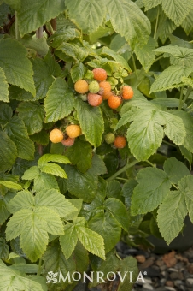
Tahoe Fruit & Vegetable Workshop Series
Raspberries and a Gooseberry
Fall Gold Raspberry
This is a primocane variety. Treat as a floricane, removing late summer flowers. Not as cold hardy as red varieties, but should do well in most locations in Tahoe/Truckee. Introduced by E.M. Meader of NH in 1968. Plants need support but are upright.
Monrovia Nursery
Co-operative Extension Tahoe Basin Master Gardeners

Slide 24
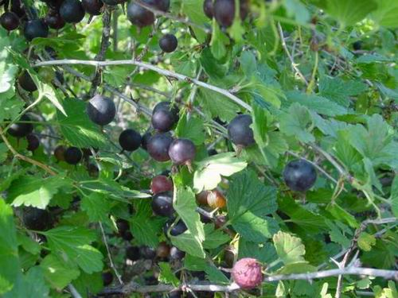
Tahoe Fruit & Vegetable Workshop Series
Gooseberry
The gooseberry is in the Grosulariacea family and the genus Ribes. The European cultivated species is R. uva-crispa.
There are many North American species. The common species used for crosses is R. hirtellum.
Ribes hirtellum – Cornell University Image
Co-operative Extension Tahoe Basin Master Gardeners

Slide 25
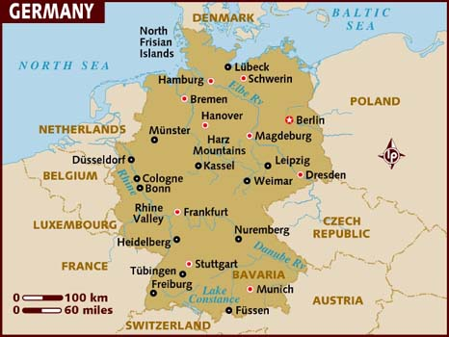
Tahoe Fruit & Vegetable Workshop Series
Gooseberry
Cultivation
Germany is the world’s leading producer of gooseberries 170,000 tonnes followed by Poland at 168,00 tonnes. Third place is Russia at 50,000 tonnes. In the US only about 50 tonnes are produced on an only 120 acres.
FAOSTAT United Nations
Lonely Planet Image
Co-operative Extension Tahoe Basin Master Gardeners

Slide 26
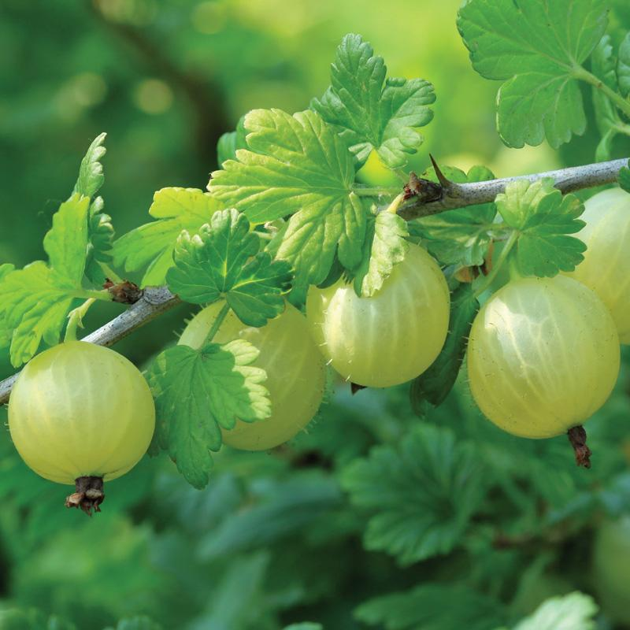
Tahoe Fruit & Vegetable Workshop Series
Gooseberry
Gooseberry Planting Instructions I
Keep roots moist until planting
Select a sunny location
Dig a hole 2 times the depth and width of the planting
Amend soil with compost and/or manure.
Place plant into the hole spreading roots.
Stark Brothers’ Nursery Image
Co-operative Extension Tahoe Basin Master Gardeners

Slide 27
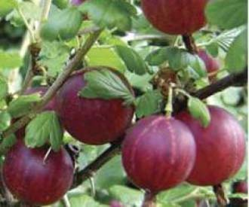
Tahoe Fruit & Vegetable Workshop Series
Gooseberry
Gooseberry Planting II
Plant so the crown section is 2-3 inches below ground surface. Note this might put the lower portion of branches below ground level which is ok.
Water frequently the first few weeks but do not let the plant become waterlogged.
Fertilize with manure or a general purpose fertilizer after the first month. About 3 pounds manure/plant or 4 ounces of a 10-10-10 per plant.
Keepers Nursery Image
Co-operative Extension Tahoe Basin Master Gardeners

Slide 28
Tahoe Fruit & Vegetable Workshop Series
Gooseberry
Captivator Gooseberry
This is a European (or a cross with American natives) variety that is cold tolerant and productive. The fruit when ripe will be red in color. Resistant to powdery mildew and pine blister rust. Fruit may drop to ground when ripe. Very cold hardy. Developed at Central Experiment Farm, Ottawa in 1949
University of Wisconsin Image
Co-operative Extension Tahoe Basin Master Gardeners

Slide 29
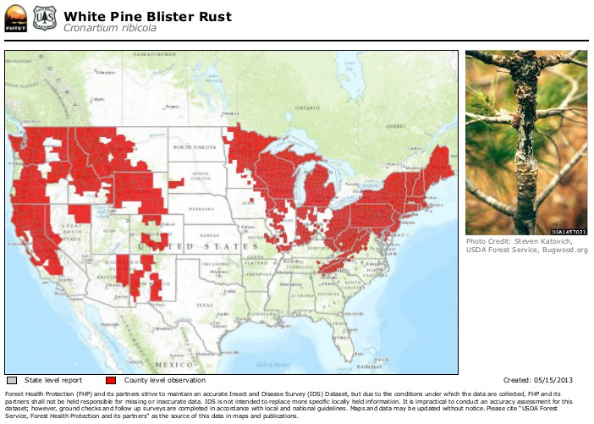
Tahoe Fruit & Vegetable Workshop Series
Gooseberry
White Pine Blister Rust I
White Pine Blister Rust is a fungal infection (Cronartium ribicola) that affects 5 leaved pines like Sugar Pine and White Bark Pine.
The disease also affects Ribes, Indian Paint Brush and Lousewort plants
USDA Image
Co-operative Extension Tahoe Basin Master Gardeners

Slide 30
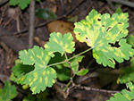
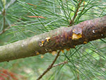
Tahoe Fruit & Vegetable Workshop Series
White Pine Blister Rust II
Gooseberry
White Pine Blister Rust has a life cycle that requires infecting the pines followed by the return to the shrubs.
In late summer spores are carried to the pines during cool moist periods. The spores affect pine needles if sufficient moisture exist.
The fungus moves from needle to branch to trunk forming cankers as it moves through the tree’s xylem tissue eventually killing the tree. Rate of movement is averages 3 inches/year.
University of Minnesota Extension Images
Co-operative Extension Tahoe Basin Master Gardeners

Slide 31
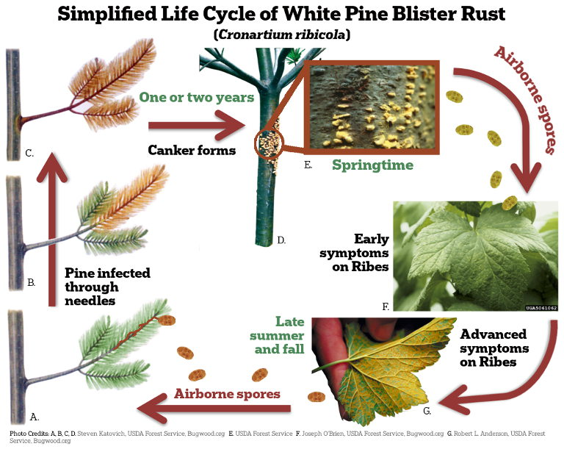
Tahoe Fruit & Vegetable Workshop Series
Gooseberry
White Pine Blister Rust III
The cankers develop blister like structures at their margin, which erupt releasing powdery yellow orange spores called aeciospores which affect the Ribes.
It is recommended not to plant Ribes within 100 yards of a 5 needle pine tree.
Plant Heroes Image
Co-operative Extension Tahoe Basin Master Gardeners

Slide 32
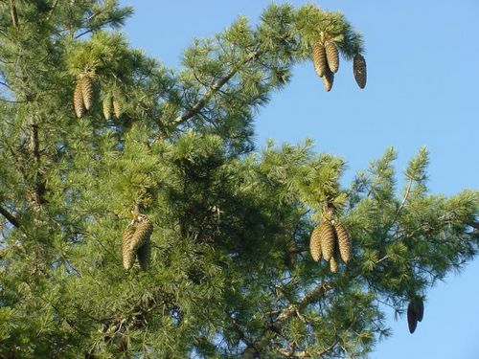
Tahoe Fruit & Vegetable Workshop Series
White Pine Blister Rust IV
Gooseberry
White Pine Blister Rust originated in Asia, where many pines and Ribes developed a resistance to the fungus.
By the 18th Century it had become established in Europe.
It was inadvertently introduce to North America through European white pine seedlings grown for the nursery trade.
The US government and many state forestry Departments prohibited planting of Ribes and had an active eradication program. In 1967 the Federal Government eliminated the prohibition as did many states.
Development of resistant cultivars, inability to remove all host plants, and removal or pruning of infected trees lessened the need for prohibitions.
Calscape Image
Co-operative Extension Tahoe Basin Master Gardeners

Slide 33
Tahoe Fruit & Vegetable Workshop Series
Raspberries and a Gooseberry
Fun Fact:
Sagittarius B2, a dust cloud at the center of the Milky Way, includes the molecule ethyl formate , which is one of the compounds behind the flavor of raspberries and the scent of rum.
NASA Image
Co-operative Extension Tahoe Basin Master Gardeners

Slide 34
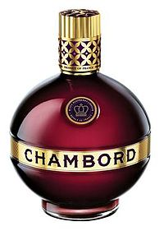
Tahoe Fruit & Vegetable Workshop Series
Raspberries and a Gooseberry
Chambord Liqueur is a raspberry infused Cognac that is based on a 17th century formula that uses both black and red raspberries. In addition to the berries, vanilla, citrus peel and honey are part of the formula. The product was originally made in the Loire Valley in France
Co-operative Extension Tahoe Basin Master Gardeners

