Slide 1
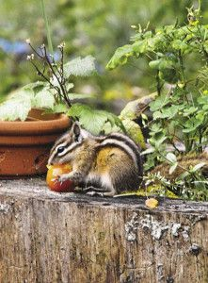
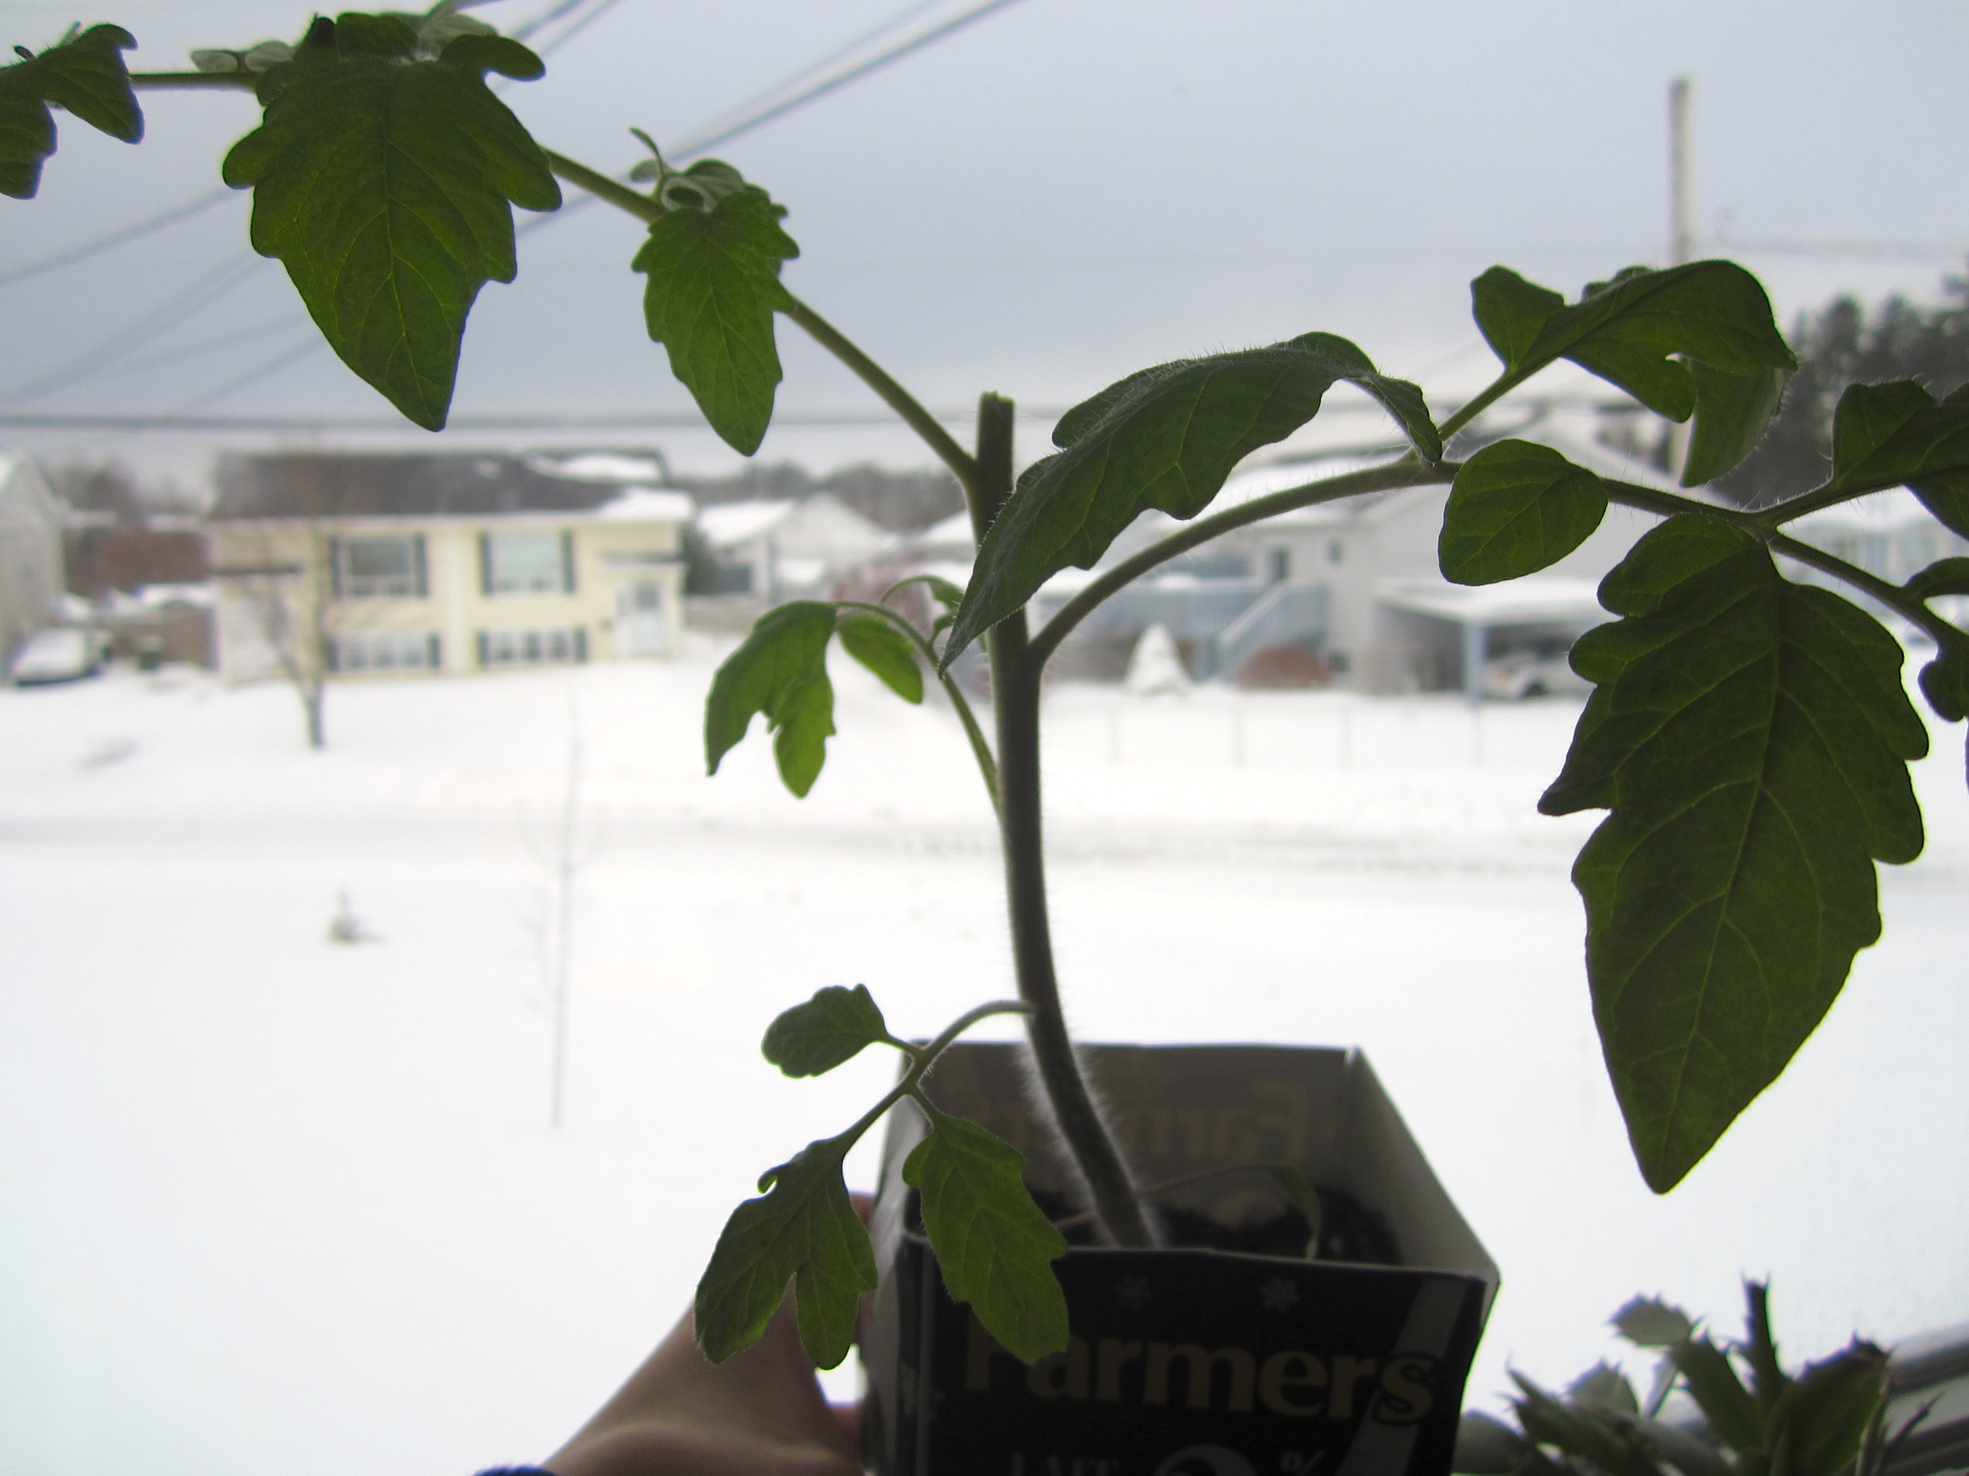
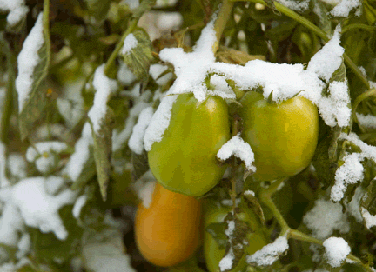
Are you Kidding Me – Growing Tomatoes at Tahoe ?
Tahoe Fruit & Vegetable Workshop Series
Tahoe’s Problem Child – The Tomato
passingthru.com image
Hobby Junkies image
Pinterest image
Co-operative Extension Tahoe Basin Master Gardeners

Slide 2
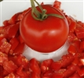
Growing Tomatoes at Tahoe
Tahoe Fruit & Vegetable Workshop Series
Topics covered:
1. Project overview
2. Phenology
3. Taxonomy and anatomy
4. Planting and care
5. History and culinary aspects
6. Varieties and Supplier information
7. Distribution of plant materials
Beaver Lodge
TomatoFest Image
Co-operative Extension Tahoe Basin Master Gardeners

Slide 3
Growing Tomatoes at Tahoe
Tahoe Fruit & Vegetable Workshop Series
Master Gardeners are community members who have been trained under the direction of the University of California (Davis) Cooperative Extension. 50 hours of formal classroom training
We assist the UC Cooperative Extension by providing practical, scientific gardening information to the home gardeners in the Lake Tahoe Basin.
The Lake Tahoe Master Gardeners offer research-based information by:
Answering questions via email hotlines, farmers markets and at community events.
Offering workshops and classes
Campbell Soup Co. image
Co-operative Extension Tahoe Basin Master Gardeners

Slide 4
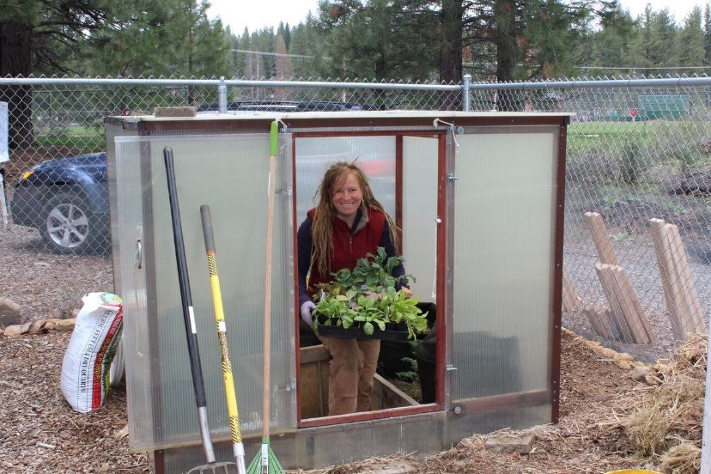
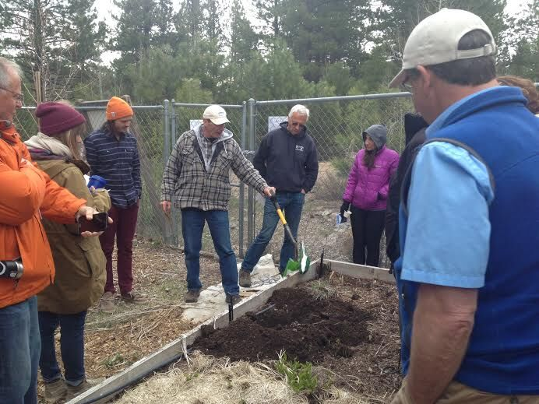
Growing Tomatoes at Tahoe
Tahoe Fruit & Vegetable Workshop Series
Master Gardeners
Work with School Gardens
Work with Community Gardens
Do workshops
Co-operative Extension Tahoe Basin Master Gardeners

Slide 5
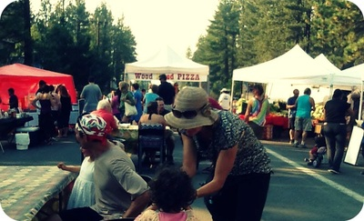
Growing Tomatoes at Tahoe
Tahoe Fruit & Vegetable Workshop Series
Master Gardeners also
Answer Basic Gardening questions at Farmers’ Markets
Plant Sales
Most common answer to any question:
It depends
Co-operative Extension Tahoe Basin Master Gardeners

Slide 6
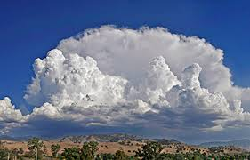
Growing Tomatoes at Tahoe
Tahoe Fruit & Vegetable Workshop Series
Phenology
Phenology looks at growth and development differences between plant varieties that are due to weather and climate.
Merriam-Webster on-line Dictionary
Varietal Comparative Phenology (VCP) looks at growth and development differences between plant varieties that are due to weather and climate
Co-operative Extension Tahoe Basin Master Gardeners

Slide 7
Growing Tomatoes at Tahoe
Tahoe Fruit & Vegetable Workshop Series
Why Tomatoes?
Arguably the most common vegetable grown by US home gardeners
The most widely canned or bottled (commercially) vegetable
Challenge to grow in Tahoe/Truckee (No Kidding)
Gained legal status (for commerce) as a vegetable (1893)
Nix v Hedden
The first commercially available genetically modified food licensed for human consumption was Calgene’s Flavr Savr tomato, first sold in 1994 and discontinued in 1997
Co-operative Extension Tahoe Basin Master Gardeners

Slide 8
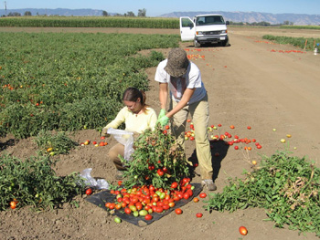
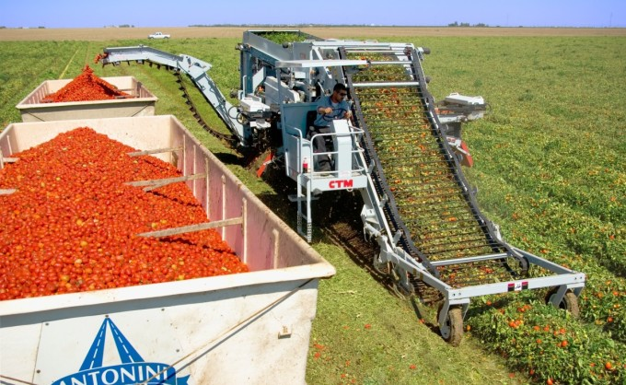
Growing Tomatoes at Tahoe
Tahoe Fruit & Vegetable Workshop Series
California leads the nation in total tomato production
Florida and California are neck and neck in fresh tomato production
China is the world production leader followed by India and the US.
Egypt, Tunisia and Turkey have the highest per capita consumption
Italy exports more processed tomatoes than any country
UC Davis images
Co-operative Extension Tahoe Basin Master Gardeners

Slide 9
Growing Tomatoes at Tahoe
Tahoe Fruit & Vegetable Workshop Series
Did you know
Eating tomatoes were featured on an episode of “ You Were There!” on radio and television
The longest tomato vine was 65 feet in length
The biggest tomato weighed and amazing 7 pounds 12 ounces
The record for tomato production by a single plant is 342 lbs.
In 2000 the Heinz Co. introduced colored ketchups. – Called Easy Squirt the colors were purple, green and blue. By 2003 all were discontinued.
Co-operative Extension Tahoe Basin Master Gardeners

Slide 10
Growing Tomatoes at Tahoe
Tahoe Fruit & Vegetable Workshop Series
Tomatoes are in the Solanaceae family as are potatoes, nightshade (belladonna) and eggplant
Tomatoes can be classified based on fruit color, size/shape, or type of plant growth
The tomato, Solanum lycopersicum is native to South America, but was not known to be used there as a food. It was a food in Mexico.
Apologia Biology for Home School Image
Co-operative Extension Tahoe Basin Master Gardeners

Slide 11
Growing Tomatoes at Tahoe
Tahoe Fruit & Vegetable Workshop Series
Pliny the Elder ( 23-79 AD) is generally credited with providing the name to the genus Solanum. Two possible meanings – a. In need of sun; or b. Soothing
Linneaus gave the species name, lycopersicum derived from the common name used in Germany and elsewhere (wolf peach)
wikipedia
Co-operative Extension Tahoe Basin Master Gardeners

Slide 12
Growing Tomatoes at Tahoe
Tahoe Fruit & Vegetable Workshop Series
Defining Tomatoes
Tomato by color:
Red
Pink
Orange
Purple or Blue/Black
Yellow
Green
Striped
Tomato by plant growth:
Determinant
Indeterminate
Semi determinate
Tomatoes by size or shape:
Current
Grape
Cherry
Plum
Pear
Standard
Beefsteak
Ox Heart
UC Davis Image
Co-operative Extension Tahoe Basin Master Gardeners

Slide 13
Growing Tomatoes at Tahoe
Tahoe Fruit & Vegetable Workshop Series
Determinant varieties usually have more compact bush shapes and fruit ripen within a brief window, with plants dying shortly after fruit ripen. Sometimes called bush type tomatoes. Common type for processed tomatoes.
Roma type determinant tomato
UC Davis Image
Indeterminate varieties are referred to as vine type tomatoes continue to grow, flower and produce fruit until killed by frost or lack of water. In southern climates may overwinter, or resprout from base.
Co-operative Extension Tahoe Basin Master Gardeners

Slide 14
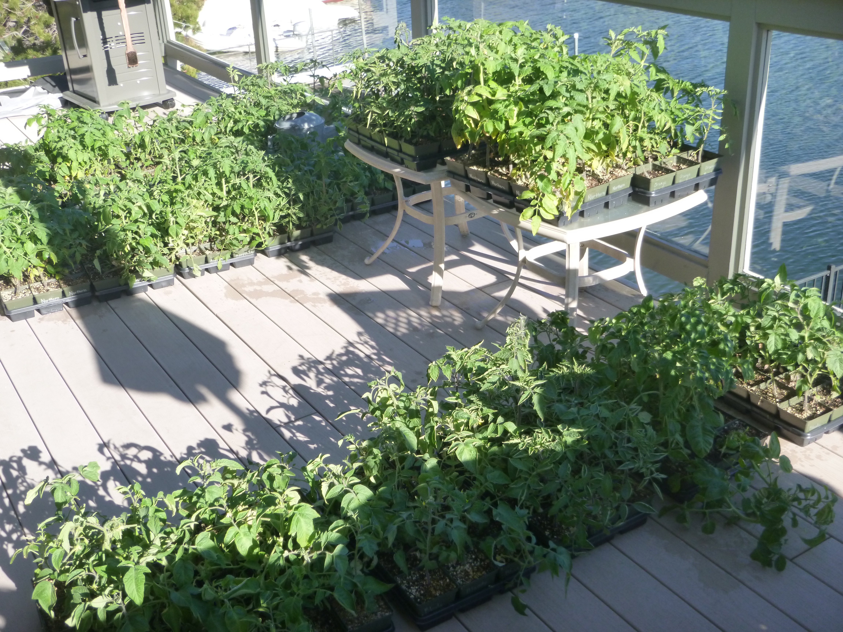
Growing Tomatoes at Tahoe
Tahoe Fruit & Vegetable Workshop Series
Definitions
Optimist – A Gardener in Tahoe/Truckee
Masochist – Someone attempting to grow tomatoes in Tahoe/Truckee
Sadist – Someone who successfully grows tomatoes in Tahoe/Truckee and who reminds you of it - regularly
Co-operative Extension Tahoe Basin Master Gardeners

Slide 15
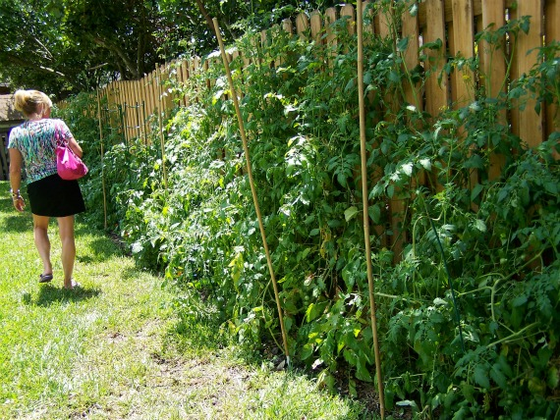
Growing Tomatoes at Tahoe
Tahoe Fruit & Vegetable Workshop Series
Select site that maximizes heat, daylight and protection
Planting next to a fence or wall (south or west side) allows for radiated heat at night
Co-operative Extension Tahoe Basin Master Gardeners

Slide 16
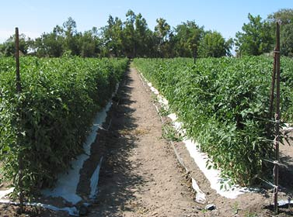
Growing Tomatoes at Tahoe
Tahoe Fruit & Vegetable Workshop Series
Soil pH of 6.2-6.8 (Tahoe/Truckee OK) gives best results. Prepare planting area by mixing in 2 pounds of 10-10-10 fertilizer per 100 sq. ft. If planting area is low in organic matter, add some well-aged compost to improve moisture holding capacity. If planting in raised bed or containers, consider adding some silica sand or pearlite into the soil mix to help loosen the soil and allow better percolation of water.
Trellised Rows of Heirloom Tomatoes
TomatoFest Image
Co-operative Extension Tahoe Basin Master Gardeners

Slide 17
Growing Tomatoes at Tahoe
Tahoe Fruit & Vegetable Workshop Series
Use of perforated plastic groundcover (clear or red) helps in raising and maintaining soil temperatures as well as help retain soil moisture
Co-operative Extension Tahoe Basin Master Gardeners

Slide 18
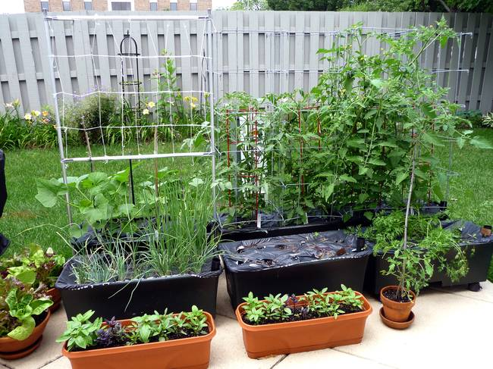
Growing Tomatoes at Tahoe
Tahoe Fruit & Vegetable Workshop Series
Bonnie Plants
Darker colored containers help warm the soil
Co-operative Extension Tahoe Basin Master Gardeners

Slide 19
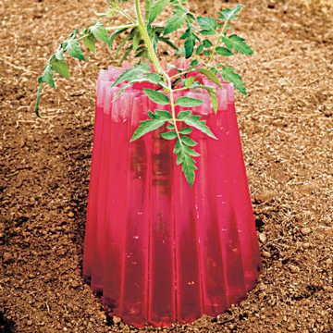
Growing Tomatoes at Tahoe
Tahoe Fruit & Vegetable Workshop Series
Water storage systems are placed around or near plants for cold weather protection. A cheap system is to use plastic storage bags with colored water
Co-operative Extension Tahoe Basin Master Gardeners

Slide 20
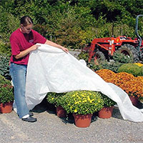
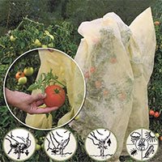
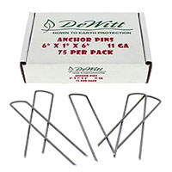
Growing Tomatoes at Tahoe
Tahoe Fruit & Vegetable Workshop Series
Greenhouse Megastore Images
Tomato hood
Methods for frost or cool weather protection are important for tomato production in Tahoe/Truckee
Insulated row cover with water bag
Anchor pins
Frost Blanket
Co-operative Extension Tahoe Basin Master Gardeners

Slide 21
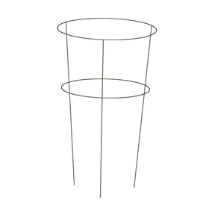
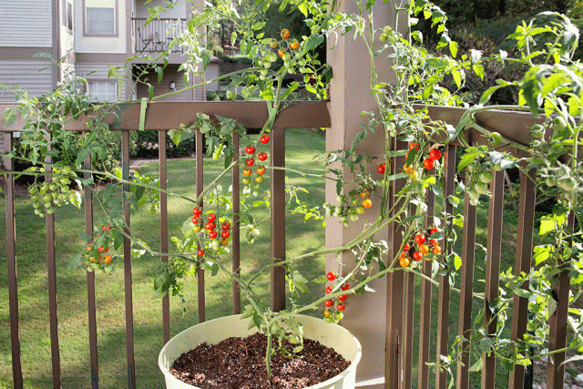
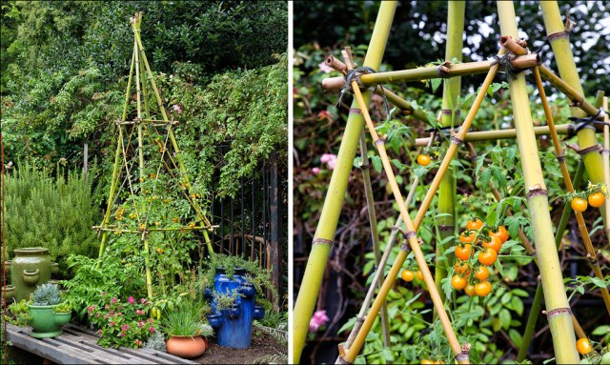
Growing Tomatoes at Tahoe
Tahoe Fruit & Vegetable Workshop Series
Support of vines essential
Mother Earth
Bonnie Plants
Bonnie Plants – Bamboo trellis
Lowes Image
Co-operative Extension Tahoe Basin Master Gardeners

Slide 22
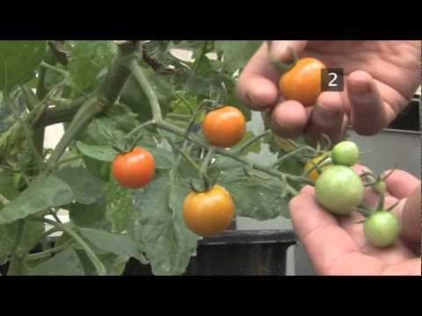
Growing Tomatoes at Tahoe
Tahoe Fruit & Vegetable Workshop Series
Harvest and year end issues: Pick tomatoes when fully ripe if possible. As cooler weather becomes the norm in the fall, consider picking fruit when partially ripe and ripening indoors in sunny area. Alternately placing in a paper bag with other fruit will sometimes speed ripening. Another method suggested by Gary Romano – (July and Winter) is to remove the whole plant minus roots and allow to ripen on a table.
After Harvest, remove and dispose of all plants.
Co-operative Extension Tahoe Basin Master Gardeners

Slide 23
Growing Tomatoes at Tahoe
Tahoe Fruit & Vegetable Workshop Series
Pests: Aphids, cutworms, flea beetles and the ever frightening horn worms (Hawk moth) are the most common insect pests and can be controlled with good field sanitation, hand picking and encouraging beneficial insects. Every couple years there seem to be an issue with white flies. Both cutworms and horn worms can be biologically controlled with Bacillus thuringiensis containing baits or sprays. White flies and aphids can be controlled with soap sprays and horticultural oils.
Birds, mice, squirrels are best controlled with exclusion systems.
Gardening Know How image
Inaturalist image
Co-operative Extension Tahoe Basin Master Gardeners

Slide 24
Growing Tomatoes at Tahoe
Tahoe Fruit & Vegetable Workshop Series
Condensed Tomato History
Spanish find tomatoes in Mexico used as food.
First reported in Europe in 1544 from Mexican seeds.
First tomatoes in Europe probably were yellow varieties (Pomodoro or Golden Apples).
Initially not well received, except in Spanish areas such as Italy (nightshade family). Called wolf peach in many parts of Europe, though Love Apple in England.
By 1800 Tomatoes are important in many dishes, salads and deserts
Co-operative Extension Tahoe Basin Master Gardeners

Slide 25
Growing Tomatoes at Tahoe
Tahoe Fruit & Vegetable Workshop Series
Condensed Tomato History II
In the colonies and early US tomatoes were generally believed to be poisonous
Jefferson was aware of the food value from introduction to the fruit while in Europe
In 1819 Jefferson ate a ripe tomato to the astonishment of the Lynchburg populous
The southern states were first to grow and regularly eat tomatoes – due to proximity to Spanish areas where tomatoes were regularly consumed
Co-operative Extension Tahoe Basin Master Gardeners

Slide 26
Growing Tomatoes at Tahoe
Tahoe Fruit & Vegetable Workshop Series
Condensed Tomato History III
While slow to gain acceptance as a food, tomatoes made “National News” as a medicine for all that ailed you. With Tomato Pills (containing the undefined extract tomatine).
In Hartford Connecticut (1839) as much as 30% of the entire newspaper consisted of tomato pill advertisements.
From the claimed health benefits, people started growing, consuming and enjoying tomatoes. Many recipes that originated in the south were published.
The fresh tomato demand led to inventiveness
And… the tomato surplus led to industrial opportunity
Co-operative Extension Tahoe Basin Master Gardeners

Slide 27
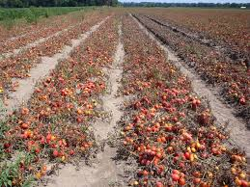
Growing Tomatoes at Tahoe
Tahoe Fruit & Vegetable Workshop Series
Condensed Tomato History IV
As the demand for fresh tomatoes grew after 1835 northeastern farmers looked at ways to be first to market where premium prices could be asked.
The yearly late season tomato glut often lowered pricing to less than the cost of growing.
The new industry of canning foods would make use of the inexpensive tomato excess.
Farmers bought land in Maryland and Virginia and used new railways to ship partially ripened tomatoes to major cities
Arrangements were made to ship tomatoes via ship up the Mississippi to northern towns
They experimented with growing in hothouses, cold frames and hotbeds
They also looked to earlier ripening varieties, and those that could transport well
Oregon State University image
Co-operative Extension Tahoe Basin Master Gardeners

Slide 28
Growing Tomatoes at Tahoe
Tahoe Fruit & Vegetable Workshop Series
Condensed Tomato History V
Joseph A. Campbell Preserve Co. 1894
While tomato canning and bottling began in earnest in the 1840s the need for war rations during the Civil War set the stage for mass production
Joseph Campbell’s started in 1869, changed name to Campbell’s Preserve Company in 1876
1897 Campbell’s condensed tomato soup introduced
1922 Campbell’s Soup Co.
1931 M’m M’m Good jingle introduced
Campbell’s Soup Company Image
Co-operative Extension Tahoe Basin Master Gardeners

Slide 29
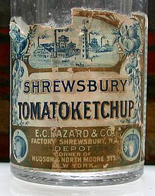
Growing Tomatoes at Tahoe
Tahoe Fruit & Vegetable Workshop Series
Condensed Tomato History VI
Ketchup was a southeast Asian invention often fermented and containing fish, but used as a condiment, not needing refrigeration.
The first tomato ketchup (called love apples) based ketchup was an 1812 recipe by Englishman James Mease and contained brandy as a preservative
The modern Ketchup (spelled many ways) began appearing in the 1860s using vinegar and sugar as partial preservatives. The Heinz Co. out competed the Hazard Tomatoketchup based in part on purity
Co-operative Extension Tahoe Basin Master Gardeners

Slide 30
Growing Tomatoes at Tahoe
Tahoe Fruit & Vegetable Workshop Series
Condensed Tomato History Epilogue
The need for uniformity in product quality and taste led to companies developing their own tomato varieties and paying farmers to grow under contract.
Most industrial tomatoes are determinate varieties that ripen uniformly
Besides taste and color, moisture/pulp ratios, size uniformity, and transportability are important, attributes that the Flavr Savr tomato was designed to address
Co-operative Extension Tahoe Basin Master Gardeners

Slide 31
Growing Tomatoes at Tahoe
Tahoe Fruit & Vegetable Workshop Series
Tomatoes in Italy
The tomato sauces of Italy are famous worldwide, with the tomato an important ingredient in the cuisine of the country. The tomato’s introduction to the Italian Peninsula date to October 31, 1548 (Before the country of Italy existed) . Seeds from Mexico were given to the Medici who had them grown on one of estates. The ripe tomatoes were brought to him while in Pisa. His response was … Eh?
It is thought that the original Italian tomatoes were yellow - Pomodora
Cosimo de’ Medici
Portrait byBrnzino
Co-operative Extension Tahoe Basin Master Gardeners

Slide 32
Growing Tomatoes at Tahoe
Tahoe Fruit & Vegetable Workshop Series
Tomatoes in Italy II
By 1559, the conclusion of the Renaissance Wars, much of the Peninsula south of Naples was controlled by Spain. The tomato was introduced and gained acceptance in this part of Italy from recipes derived from Spanish and Mexican dishes.
The processing of tomatoes into a gravy became a staple commodity by the 1880s.
Co-operative Extension Tahoe Basin Master Gardeners

Slide 33
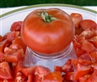
Growing Tomatoes at Tahoe
Tahoe Fruit & Vegetable Workshop Series
Siberian Red tomato
A determinant plant that consistently produces fruit in cool weather situations (reportedly can set fruit to 38° F. Tomatoes are about 4 oz. in size, bright red and round. There is confusion related to this variety so it could be considered a Russian heirloom variety, or just a cool season variety introduced in 1984. 50-65 days from fruit set.
TomatoFest Image
Co-operative Extension Tahoe Basin Master Gardeners

Slide 34
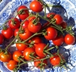
Growing Tomatoes at Tahoe
Tahoe Fruit & Vegetable Workshop Series
Alaska Fancy Tomato
This is a semi determinant plant that has small (1-2 oz.) red plum tomatoes. Plant can set fruit in cool weather and produces an early crop. 54 -60 days from fruit set.
TomatoFest Image
Co-operative Extension Tahoe Basin Master Gardeners

Slide 35
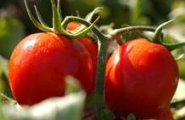
Growing Tomatoes at Tahoe
Tahoe Fruit & Vegetable Workshop Series
Legend Tomato
This determinant tomato sets fruit in cool temperature. An interesting attribute is that it’s a parthenocarpic, setting fruit without any pollination required. Developed by James Baggett at Oregon State University. The red fruit are 3-4 inches in diameter, round with few seeds. The plant is resistant to late blight. 66-70 days from fruit set.
Oregon State image by Lynn Ketchum
Territorial Seed Image
Co-operative Extension Tahoe Basin Master Gardeners

Slide 36
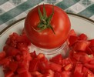
Growing Tomatoes at Tahoe
Tahoe Fruit & Vegetable Workshop Series
Sasha’s Altai-Tomatoes
Another Determinant tomato plant. The plants are said to set fruit in cool high elevation situations. Originally from Irkutsk, Siberia, brought to US in 1989 The fruit is 4-6 oz. round to slightly round shape. 55-60 days from fruit set.
TomatoFest Image
Co-operative Extension Tahoe Basin Master Gardeners

Slide 37
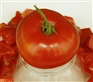
Growing Tomatoes at Tahoe
Tahoe Fruit & Vegetable Workshop Series
Silvery Fir Tree Tomato
Selected for trials based on early fruit setting and interesting foliage. Possibly from Russian origins. A determinant plant that produces 2 inch 4-5 oz. red fruit. A good choice for patio or container growing. About 54 days from fruit set.
TomatoFest Image
Territorial Seed Image
Co-operative Extension Tahoe Basin Master Gardeners

Slide 38
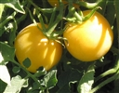
Growing Tomatoes at Tahoe
Tahoe Fruit & Vegetable Workshop Series
Peche Jaune Tomato
This is an indeterminate plant that produces a one inch round yellow fruit that has “slight fuzz”. The fruit is best eaten within a few days of picking, having mild flavor. Possibly a French heirloom variety dating to the mid 19th century and /or an original Pervian variety tracing back to the1600s. 65-70 days from fruit set.
TomatoFest Image
Tomatobomo image
Co-operative Extension Tahoe Basin Master Gardeners

Slide 39
Growing Tomatoes at Tahoe
Tahoe Fruit & Vegetable Workshop Series
Tomatoes and Nutrition
Red Tomatoes Medium size (200 gm) Yellow Tomatoes
38 Calories 32
2g Proteins 2g
10% Fiber (RDA) 6%
2% Calcium (RDA) 2%
3% Iron (RDA) 6%
5% Phosphorus (RDA) 8%
14% Potassium (RDA) 16%
11mg Sodium 49 mg
48% Vitamin C (RDA) 32 mg
2.4% Zinc (RDA) 4%
7% Vitamin D (Niacin) 13%
8% Folates (RDA) 16%
35% Vitamin A (RDA) 0%
5.4mg Lycopene 0%
Prevention.com information from Nutrient Database for Standard Reference from USDA
Co-operative Extension Tahoe Basin Master Gardeners

Slide 40
Growing Tomatoes at Tahoe
Tahoe Fruit & Vegetable Workshop Series
Tomatoes and Nutrition
Remember that undefined extract tomatine that was a cure all?
While the extract might have been bogus by the early 20th Century
the carotenoid, lycopene, had been isolated in red tomatoes which
may have some health benefits.
Lycopene availability increases with the cooking of tomtoes!
A 2010 review concluded that research has been insufficient to establish
whether lycopene consumption affects human health.
More recent studies may indicate lycopene may assist in reducing the risk of
heart diseases and certain cancers.
Co-operative Extension Tahoe Basin Master Gardeners

Slide 41
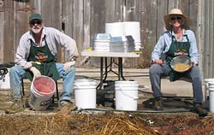
Growing Tomatoes at Tahoe
Tahoe Fruit & Vegetable Workshop Series
Most home gardeners purchase plants for transplanting into their gardens.
Open pollenated varieties can be grown from retained seeds.
1. Squeeze seeds and juice from ripe tomato into container labeled with variety name
2. Set open container in warm dark location (expect flies and odor)
3. Allow mixture to sit until surface covered in mold (white or tan). You may need to add water.
Gary and Dagma cleaning tomato seeds
TomatoFest Image
Co-operative Extension Tahoe Basin Master Gardeners

Slide 42
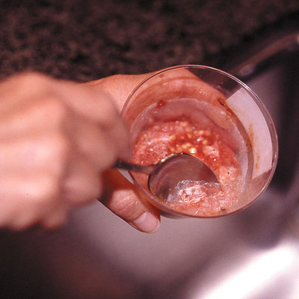
Growing Tomatoes at Tahoe
Tahoe Fruit & Vegetable Workshop Series
Scrape off mold
Fill container with water and stir slightly
Good seeds will sink
Pour off water and floating seeds retaining good seeds in container
Repeat washing until seeds are clean
Pour seeds onto a nonporous surface and spread in single layer
Allow to dry thoroughly.
Store in labeled container
Sunset Image
Co-operative Extension Tahoe Basin Master Gardeners

Slide 43
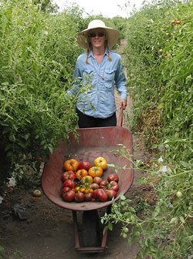
Growing Tomatoes at Tahoe
Tahoe Fruit & Vegetable Workshop Series
Gary Ibsen and Dagma Lacey operate TomatoFest farm where the grow 650 types of organic open pollenated heirloom tomatoes. While many are eaten and sold the main focus of the farm is seed sale. The farm started in 1991. Gary was also Executive Director of the Carmel TomatoFest celebrating the tomato.
Gary Ibsen
Dagma Lacey
Co-operative Extension Tahoe Basin Master Gardeners

Slide 44
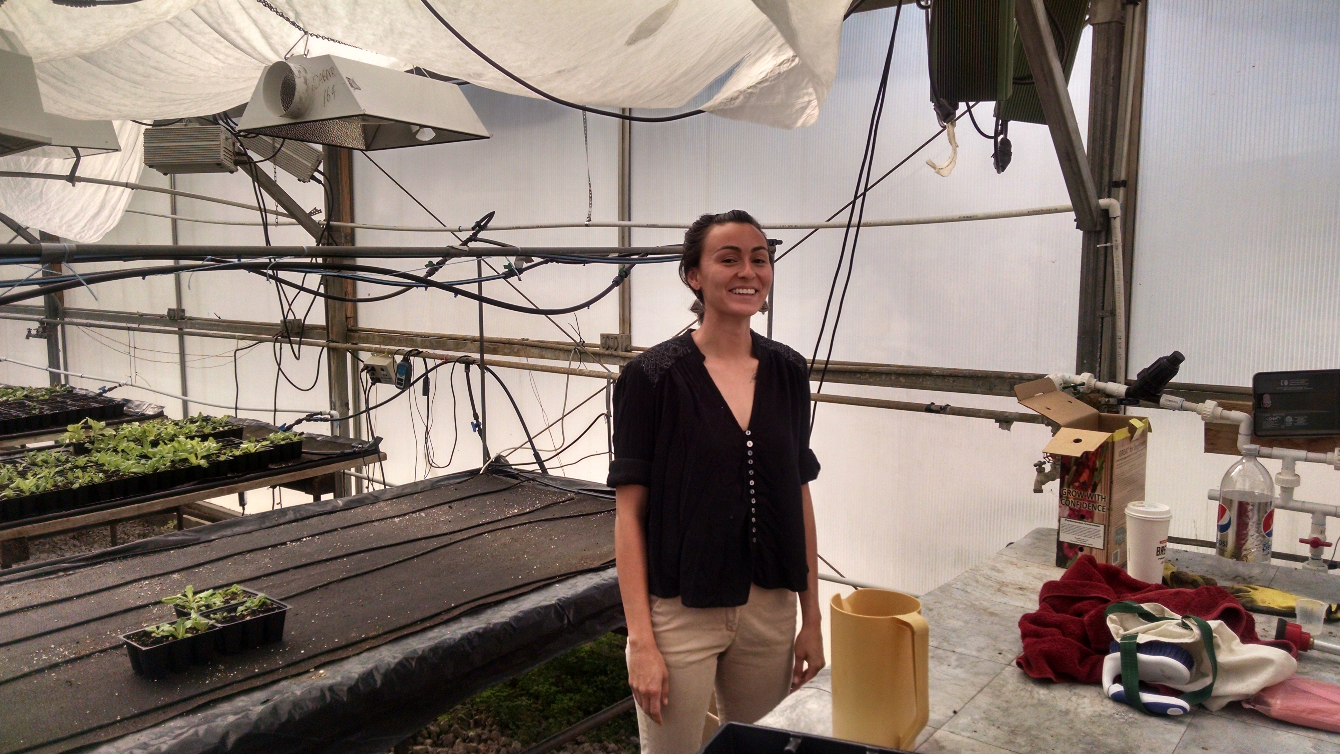
Growing Tomatoes at Tahoe
Tahoe Fruit & Vegetable Workshop Series
Alisha Cahlan, Manager of the UNR High Desert Farming Initiative. The program supports small farmers in identifying and growing higher value crops in western Nevada.
The Tahoe Master Gardener vegetable growing workshops qualified for participation – Looking at high elevation issues of food production.
Co-operative Extension Tahoe Basin Master Gardeners

Slide 45
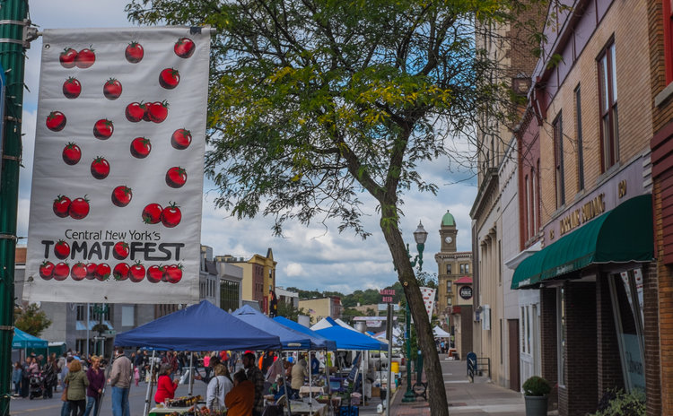
Growing Tomatoes at Tahoe
Tahoe Fruit & Vegetable Workshop Series
Tomato Festivals Are Everywhere
Los Banos – October 2018
Central New York TomatoFest – Auburn NY, September 7-8
Red Fire Farm Tomato Festival - Gransby MA, August 2018
La Tomotina Festival – Brunal Spain, August 29, 2018
Woodland CA Tomato Festival – August 11, 2018
French Market Creole Tomato Fest – New Orleans, June 2018
Bradley County Pink Tomato Festival – Warren, AR June 8/9 2018
Co-operative Extension Tahoe Basin Master Gardeners

